Slide 1
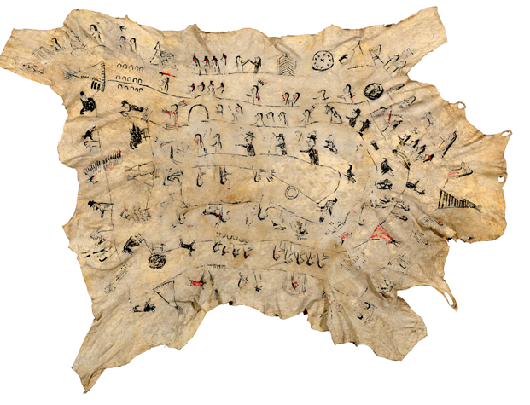
Medicine Bear,
Yanktonai Dakota (Sioux )
Winter Count
Notes:
[Slide 1]
The Montana Historical Society has many objects (artifacts) that can help us learn about the history of Montana’s First Peoples. Let’s take a look at a type of historical calendar known as a winter count and see what we can learn together.

Slide 2
Medicine Bear,Yanktonai Dakota (Sioux ) Winter Count
This activity is based on a Winter count made by Medicine Bear, Yantonai Dakota (Sioux) in the collections of the Montana Historical Society. It represents the approximate years 1823—1911.
Notes:
[Slide 2]
This winter count was made by Medicine Bear, a chief of the Yanktonai Dakota (Sioux). Like many winter counts, it is drawn on hide. Traditionally, women and girls would scrape and tan the hide, and the record keeper, usually a man, would draw the symbols. Later, winter counts were drawn on fabric or paper. Hides were large, so they could hold a lot of information—but they were also strong and easy to roll up for traveling.
Winter counts helped bands keep track of their history. Each symbol represents a particular year.
For the Yanktonais, and many other Plains Indians, the yearly cycle began with the first snowfall of the year and lasted until the first snowfall of the following year.
Ask and discuss: Why do you think the Yanktonai year started with the first snow? How is that different from our modern calendar?
Possible answers: Our calendar is tied to specific dates. Halloween always happens on October 31. New Year is always January 1. But the first snow comes at a different date each year. Because the Indians’ lives were so closely tied to the seasons and the natural world, it made much more sense to them to shape their calendar around natural events (like the first snowfall) than an exact date.
Near the end of each year, the elders would gather to discuss the significant things that had happened that year. They would pick one event to represent the year, and that year would then be named, forever, after the chosen event. An artist would then draw a symbol representing that event on the hide. The band did not always choose the most important event of the year. But they did choose one that stood out and would help them remember other events.
The job of keeper of the winter count was often passed down through the generations from father to son. If the images on the winter count became faded or worn, the keeper would make a new copy to preserve the history. That’s why this winter count is drawn with ink (a modern material) even though the first year it documents is around 1823, when the band probably did not have access to ink.
Ask and discuss: What type of materials do you think record keepers used to draw the symbols before they could buy ink?
Answer: Record keepers used paint made from natural ingredients, like plants, charcoal, or minerals, and “brushes” made from small bones or the frayed end of sticks.

Slide 3
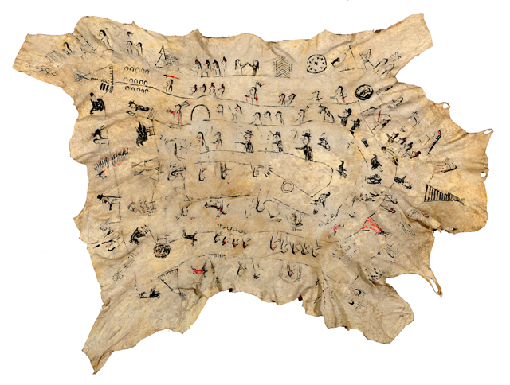
Winter Count
Start
1823
Finish
1911
Notes:
[Slide 3]
The count starts on the upper left and circles around, ending in the middle of the deer hide with a symbol representing the year 1911. Notice how the symbols go in a circle and are placed on a line that curves around? And notice how symbols stay on the line, so that some of the symbols appear upside down? Events are not placed on a straight line, like many timelines today.
Ask and discuss: Why do you think that the events follow a circle rather than a straight line?
Possible answers: We don’t really know, but many things in nature move in circles or are shaped like circles, and circles were a big part of the Plains Indians’ spiritual and material life. For example, tipi rings are also shaped like circles.
Some of the important events recorded on this winter count include flooding, smallpox epidemics, stolen horses, battles, encounters with white people, and the deaths of important people such as Sitting Bull.
Let’s investigate some of the symbols we see here.

Slide 4
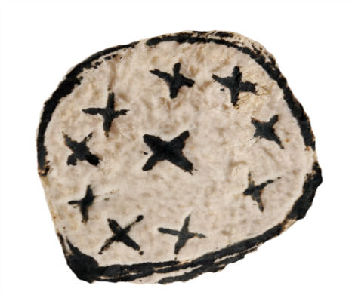
Meteor Shower
Notes:
[Slide 4]
Ask and discuss: What do you think this symbol represents? Why? What shapes and kinds of lines did the artist use to make this symbol?
Answer: The symbol of the circle with a cluster of Xs inside represents a great meteor shower that is known as the year “that the stars fell.” This meteor shower took place on November 12, 1833.
Ask: Was this a natural event or did humans cause it to happen? Answer: Natural.
Ask and discuss: Now that you know what the symbol stands for, does it look like that to you? How would you represent that event?
Ask: Do you think that this is the only winter count that documented this meteor shower? Why or why not?
Answer: Many winter counts documented this same event using similar symbols.

Slide 5
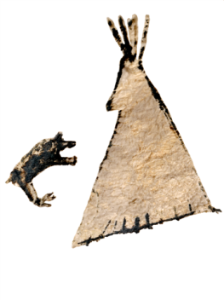
Heart River
Notes:
[Slide 5]
Ask: What is going on in this drawing? What do you see that makes you say that?
Answer: This picture refers to a winter camp on the Heart River in 1834 that was frequented by a bear. The bear stayed with the camp all winter long.
Ask: Now that you know what the symbol represents, do you think it looks like what it means?

Slide 6
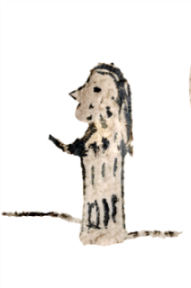
Smallpox Epidemic of 1837
Notes:
[Slide 6]
Ask: What do you think this symbol represents? Why?
Answer: This image refers to the second year of a devastating smallpox epidemic. It began in 1837 and continued into 1838. Many tribal members died.
Ask: What do you see in this symbol that could represent the disease? Answer: Dots.
Ask (upper grades): Does anyone know why smallpox was so dangerous to American Indians?
Answer: The disease was common in Europe and Asia, but not in the Americas. Because the Indians had never been exposed to the disease before, their bodies had no resistance to it, and many people died.

Slide 7
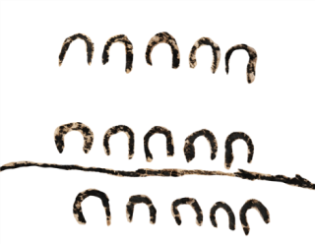
Sioux Horses
Notes:
[Slide 7]
Ask: What do you think this picture symbolizes?
Answer: These horse tracks refer to the capturing and/or killing of many prized Sioux horses by their enemy, the Crows, in about 1860 or 1861.
Ask and discuss: How do we know that the symbol represents the Crows stealing Sioux horses, instead of the other way around?
Answer: We know this because of the oral tradition. Remember, the elders of the band talked about what events they wanted to record. The record keeper then came up with a symbol (often using common figures) to represent that event. That symbol became a tool to help people remember the stories they wanted to tell. They would talk about the event and pass down the stories of the event through the generations.
Ask and discuss: Think about symbols we use today (like a stop sign, McDonald’s arches, or the number 2). Would an alien from outer space know what those symbols stand for just by looking at them?
Possible answer: No. Symbols don’t necessarily look like what they are representing. We know what a symbol means because we are told that is what it means. It stands for a larger idea. The same is true for symbols on the winter count.
Ask and discuss: Can you think of another symbolic way to represent a horse? What about a number of horses? How did this symbol work to relate a lot of information in a small space?

Slide 8
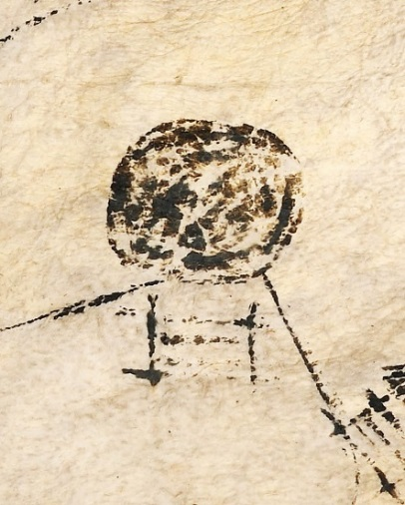
A Withering Year
Notes:
[Slide 8]
Ask: What do you think this picture symbolizes?
Answer: This symbol refers to ‘a withering year’ [wither means to dry up and die]. We don’t know for certain if it represents hard weather or is a reference to the fallout of the Battle of the Greasy Grass, the Sioux name for the Battle of the Little Bighorn. 1877 was a hard year. Although the Sioux and their allies won the Battle of the Greasy Grass in 1876, they lost the war and many of the people were forced onto reservations. This year marks the first of the remaining entries to include a palisade [a tall fence] before the figure. This represents the “prison” era, or the beginning of the reservation period.
Ask and discuss (upper grades): Why can’t we say for certain what the symbol represents? When this winter count was being used by the Yanktonai2, would they have known what the symbol meant?
Possible answer: During the reservation and boarding school periods, tribes lost a lot of traditional knowledge, including how to read some of the winter count symbols. Before that time, the tribe would have talked about the symbol and the event when they read the winter count. Stories would have been passed down from generation to generation, including the meaning of this symbol.

Slide 9
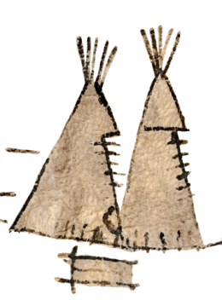
The Return of Gall
Notes:
[Slide 9]
Ask: What do you think this symbol represents?
Answer: This image refers to the return of Gall and his band from Canada. Gall, along with Sitting Bull, was an important chief, who wanted to keep the Great Plains for the Sioux. He helped lead the resistance against the U.S. military, which wanted to disarm the Sioux and confine them on a reservation. His band fought many battles against the U.S. government before fleeing to Canada in 1877. In 1880 Gall brought his band back from Canada. This image shows Gall’s lodge along the Tongue River near Miles City, where in 1880 he, along with his band, surrendered at Fort Keogh on the Tongue River near Miles City. Sitting Bull and other band members surrendered in July 1881 at Fort Buford, Dakota Territory. All were ultimately transferred to the Standing Rock Reservation, which straddles the border of North and South Dakota.

Slide 10
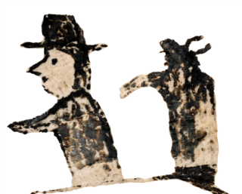
Sitting Bull
Notes:
[Slide 9]
This symbol tells us what happened to Sitting Bull about ten years after he and his people returned from Canada. Sitting Bull was shot and killed in December 1890 by Indian police who were attempting to arrest him on the Standing Rock Reservation.
Ask (upper grades): Based on what you know, why would this be an important event to document for the Sioux?
Possible answers: Sitting Bull was a very important leader, and a symbol of resistance. He wanted to keep the Great Plains for the Sioux and helped lead the resistance against the U.S. military, which wanted to disarm the Sioux and confine them on a reservation. His death marked the end of an era.
Now that we’ve looked at some of the winter count symbols the Yanktonais used, let’s talk more about them.
Ask and discuss: What types of events did the band choose to record on their winter count? Why don’t the symbols look more like a realistic painting of actual events? How did the record keeper utilize the space to record a period of eighty-eight years?
Possible answers: Some of the events were sad (smallpox), but not all of them. Some were caused by nature (meteor shower) and some by humans (death of Sitting Bull). What they had in common was that they were always memorable. One of the reasons that record keepers used symbols instead of realistic paintings was because, by using symbols, they could pack a lot of information into a small space.
Ask and discuss: Why were winter counts important to the tribes in historic times? Why are they important today?
Possible answers: The pictographic symbols helped people remember their history. They remain important, especially to American Indian communities, because they continue to strengthen tribal ties by reminding people who they are and where they came from. They are important to everyone—both Indians and non-Indians—because they help us understand how people lived long ago and how our world has changed.

Slide 11
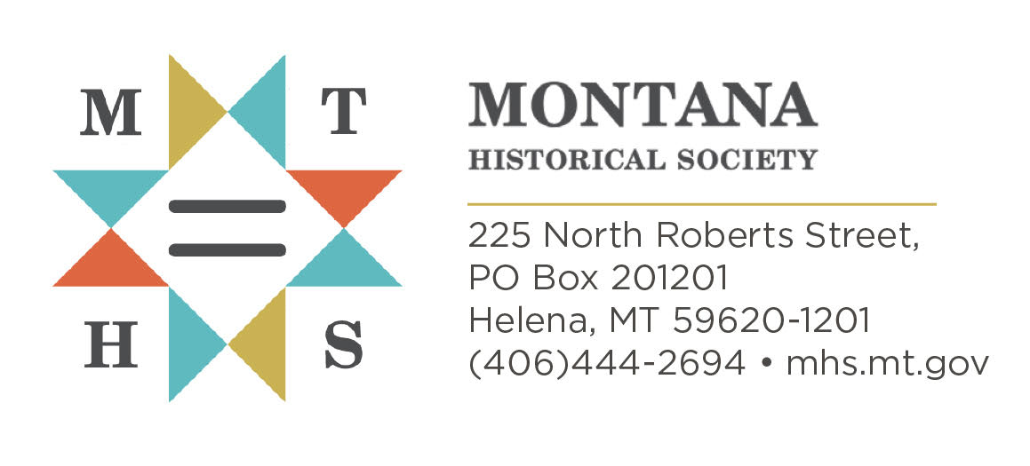

This curriculum is provided through
a partnership of the
Montana Historical Society
and the
Montana Office of Public Instruction
Indian Education for All Division
Notes:
[Slide 10] This production is provided through a partnership between the Montana Historical Society and Montana Office of Public Instruction Indian Education for All Division. Unless otherwise noted, all objects are from the collections of the Montana Historical Society.
ADA Revision 08/2025

