Slide 1
HOPE IN HARD TIMES
Based on a traveling exhibit of the
Montana Historical Society
Guest curated by Mary Murphy, Michael P. Malone Professor of History, Montana State University

Slide 2
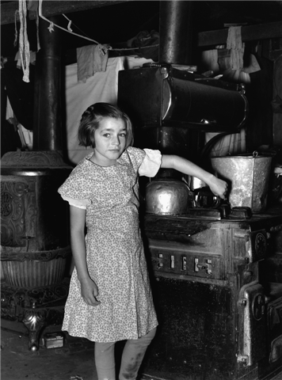
Bess Harshbarger was one of the fifteen children that made up the Harshbarger household in 1937 (later, there would be two more). All of the children did chores around the house and farm, including caring for their younger siblings.
Russell Lee, Bess Harshbarger, Nine Years Old, Sheridan County, November 1937

Slide 3
Montana in the Great Depression
“We didn’t miss any meals, but we had a number that was kind of skinny.”
—Doris Gribble, Helena
In 1931, John Hauge wrote to Governor John Erickson from Paradise, Montana: “I’m taking the liberty of writing you to see if there is anything you can possible [sic] do for the unemployed people of Sanders County. Work is what they want not dole. The world owes no man a living, but it certainly owes all of its people a chance to make a living.”
Notes:
In 1931 all of Montana was struggling.
The Great Depression, inaugurated by the stock market crash of 1929, had thrown the country into economic chaos, and Montana felt the shock waves.
In Missoula lumber mills laid off between 33 and 89 percent of their workers, and in Butte the mining work force shrank by 84 percent. A lingering drought dashed the hopes of eastern Montana farmers and ranchers. Mrs. H. Frederickson from Opheim also wrote the governor describing her family’s plight: “I cannot give my children any more schooling after the 8th grade because we have not the means to do so . . . No crop for 3 years . . . No money to be gotten . . . I can not get a job and work for there is no work . . . Can you advice me what to do?”
Governor Erickson had no answers for Montana citizens. By 1932 the state and private charities, such as the Red Cross, had exhausted their relief resources.

Slide 4
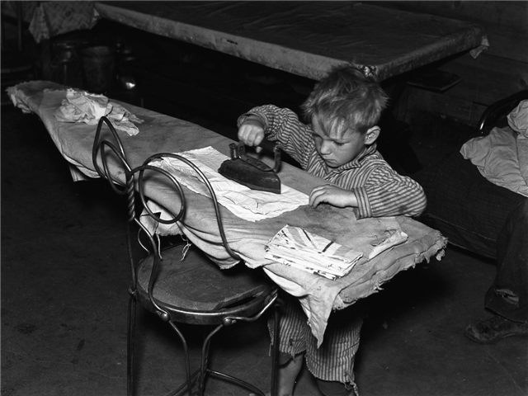
FSA photographers frequently focused on rural children in an effort to drum up public support for New Deal relief programs. A decade of hard times and high unemployment caused Americans to fear what effect inadequate diet, erratic schooling, and a future of joblessness might have on the country’s youth.
Russell Lee, Jim Harshbarger, Five Years Old, Sheridan County, November 1937

Slide 5
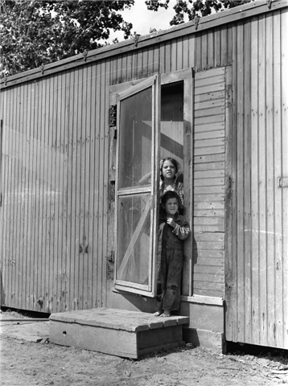
By 1930 more than a thousand Mexicans and Mexican Americans, recruited by the Great Western and Holly Sugar companies, worked in the sugar beet fields of the lower Yellowstone Valley.
Families lived in makeshift dwellings, like this modified railroad refrigerator car, and children labored alongside their parents hoeing, thinning, weeding, pulling, and topping the beets.
Arthur Rothstein, Sugar Beet Workers’ Children, Treasure County, June 1939

Slide 6
My father had 320 acres. But Eastern Montana is not the kind of country that should ever have been plowed up.—Mary Frances Alexander McDorney, Missoula You didn’t have any rain for, Christ, very little for years. A big cloud would come up, I can remember, big clouds come up and you’d think, boy this is gonna be a good one. All it was [was] dust.—Wallace Lockie, Miles City In the ’30s you couldn’t give nothing away. Nobody had any money. Well, you could buy a set of overalls for 25 cents and nobody had 25 cents. But we stayed clean. That’s one thing that we did. We were poor but we were clean and poor. If our overalls were patched it was clean patching. People were proud.—Wallace Lockie, Miles City At noon it was just like before the sun goes down—twilight, that’s the way it was at noon . . . it was just a glitter of grasshopper wings. —Ethel George, Kinsey

Slide 7
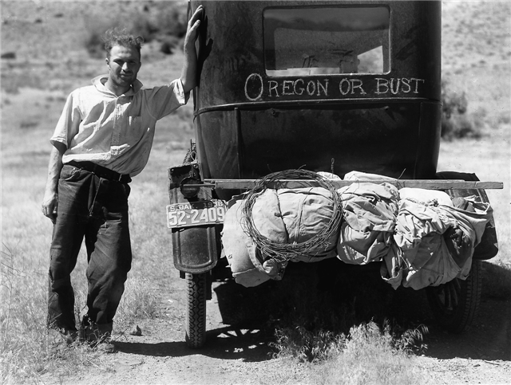
After drought drove the Evans family off their South Dakota farm, Vernon Evans was photographed near Missoula en route to Oregon, where the family had heard “there was grass up to the cow’s belly, and there was fruit free for the picking.”
Arthur Rothstein, Drought Victims Heading to Oregon, Near Missoula, July 1936

Slide 8
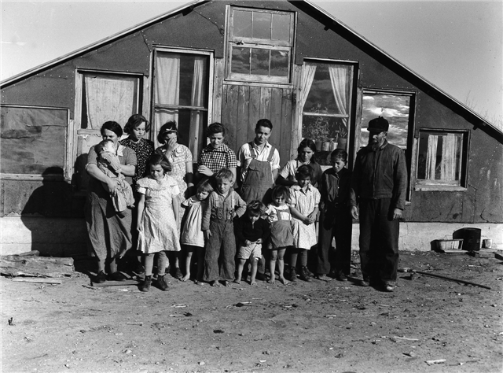
The Harshbarger home had been built to house chickens, but after it was completed, Mrs. Harshbarger decided that it would be warmer than their homestead cabin, so the family moved into this twenty-four-foot-square, one-room building.
Russell Lee, John and Mayree Harshbarger and Their Family, Sheridan County, November 1937

Slide 9
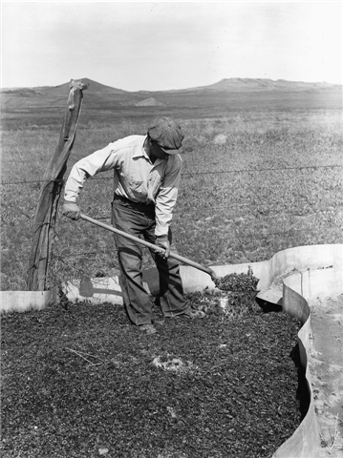
Hordes of Mormon crickets infested eastern Montana between 1936 and 1941. Farmers defended their crops from the invaders by building metal barriers around grain fields to stop their march and then dusting the insects with poison to kill them.
Arthur Rothstein, Cleaning a Cricket Trap, Big Horn County, June 1939

Slide 10
Grasshoppers by the jillions. Ate up the fence posts. . . . I don’t tell the other people too much about it anymore because they think I’m lying. It was terrible. It really was. It never rained at all, you know.—Wallace Lockie, Miles City
As long as you had land, you could get things on time in town and we got along better then. . . . My father could make something out of almost nothing.—Edith McKamey, Great Falls
They were just starving to death there because there was no grass, there was no hay, and they couldn’t raise grain because it was so dry.—C. Max Hughes, Miles City

Slide 11
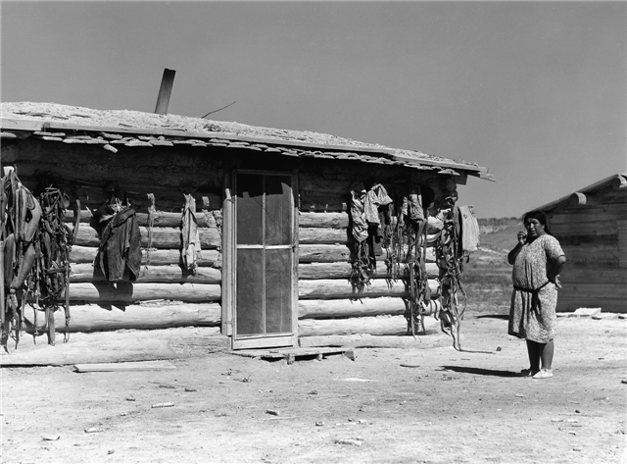
Unlike those working in some other western states, of the four FSA photographers assigned to Montana, Wolcott was the only one to document
the effect of the Depression of Montana’s Native American communities.
Marion Post Wolcott, Cheyenne Indian’s Home, Near Lame Deer, August 1941

Slide 12
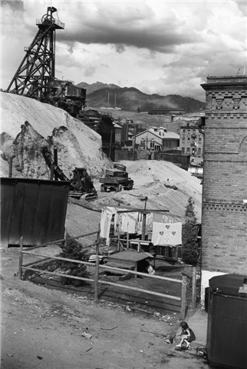
Work and home were never very far apart in Butte, as this photograph of a little girl playing in the refuse- strewn alley next to the Original Mine demonstrates.
Arthur Rothstein, Copper Mine in Town, Butte, June 1939

Slide 13
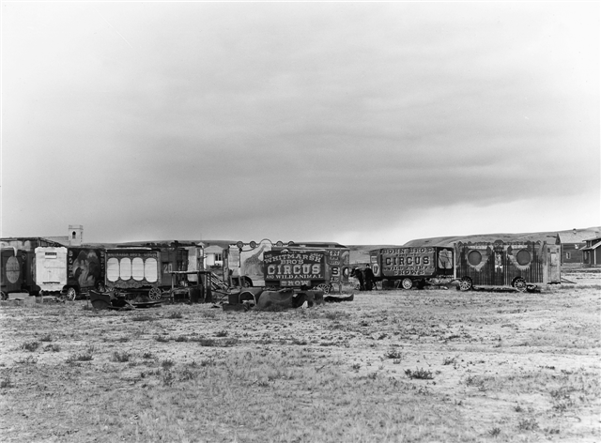
George Whitmarsh wanted a circus, so he built his own circus wagons in the town of Archer in Sheridan County. Whitmarsh had a calliope and, while he never managed to acquire a collection of wild animals, he did display a neighbor’s St. Bernard.
Russell Lee, Circus Wagons Made by Mr. George Whitmarsh, Archer, Sheridan County, November 1937
Notes:
Calliope: Also called steam organ, a musical instrument consisting of a set of harsh-sounding steam whistles that are activated by a keyboard.

Slide 14
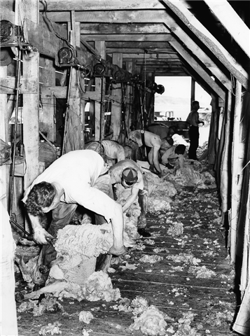
Crews of sheep shearers traveled throughout the West, wielding their shears in the sheds of the region’s woolgrowers. These sheepshearers are using electric cutters that had become common by the early 1910s. One worker uses a belt to brace himself during the grueling day bent over grasping sheep and shears.
Arthur Rothstein, Shearing Sheep, Rosebud County, June 1939

Slide 15
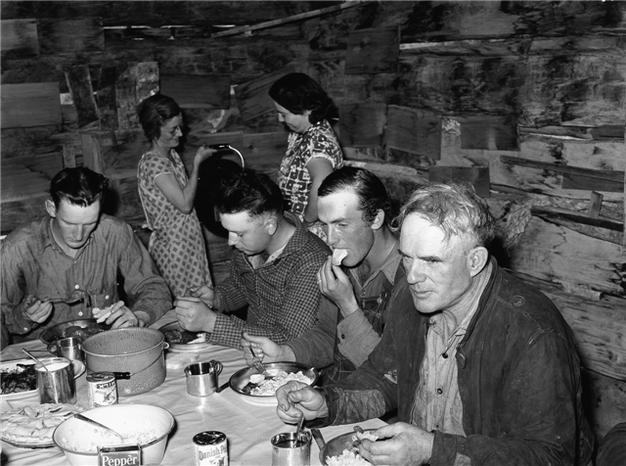
After washing up and combing their hair, sheepshearers sat down for a dinner of meat, potatoes, coffee, and pie. Like harvest and roundup, shearing was a labor- intensive period for male hands and the women who cooked for them.
Arthur Rothstein, Sheepshearers at Dinner, Rosebud County, June 1939

Slide 16
The New Deal and the FSA
Our family thought that Roosevelt was a regular god because he really saved the day for all of us.
—Donald Morrow, Helena
Notes:
In November 1932 Americans elected Franklin Delano Roosevelt to the presidency. To spur economic recovery and administer relief, the Roosevelt administration created the alphabet soup agencies that have become such a familiar part of our history: the AAA, TVA, NRA, PWA, and CCC. Later came the WPA, the RA, and the FSA.
Created in 1935, the RA, or Resettlement Administration, was reorganized in 1937 as the Farm Security Administration, or FSA. In order to achieve its goal of assisting struggling farmers, the agency employed a variety of tactics. Emergency grants helped farmers weather drought and grasshopper invasion. Loans, management planning, technical assistance, and cooperative associations were designed to preserve family farms and help tenants become owner-operators.
One of the most novel, and at times controversial, programs was the resettlement project, whereby farmers on “submarginal” land were relocated to more promising farms, and the submarginal land was restored as timber or grazing reserves. Montana had some of the largest resettlement projects in the West, including Milk River Farms in Blaine, Phillips, and Valley counties; Kinsey Farms in Custer County, and Fairfield Bench Farms in Cascade and Teton counties. All these projects resettled farmers from drought-stricken dryland areas to irrigated farms. In 1936, 90 percent of the resident landowners of Garfield County petitioned the government to buy them out and allow them to resettle. They had produced only one crop in the last eight years.

Slide 17
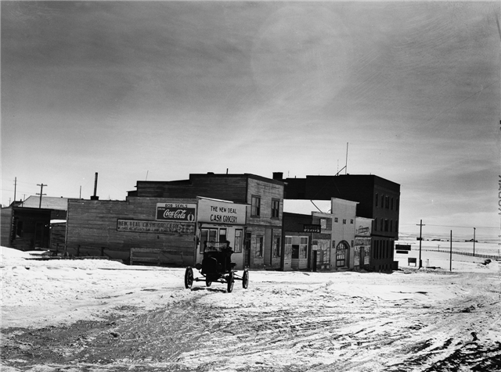
Montanans demonstrated their support for the New Deal and Democratic politicians by naming businesses and even towns in their honor. Butte had the New Deal Bar, and some Fort Peck Dam workers lived in the Hamlets of New Deal and Wheeler, the latter named for Montana’s influential senator, Burton K. Wheeler.
John Vachon, The New Deal Cash Grocery, Judith Gap, March 1942

Slide 18
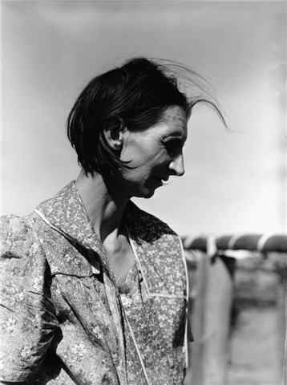
The photographers often traveled to “FSA farms” to document the hard-working men and women
who had borrowed from the program to buy land and equipment. The portrait of this woman in her print dress, calico apron, and lined face
was typical of the FSA photos of farm women.
John Vachon, Mrs. Ballinger, Wife of an FSA Borrower, Flathead Valley, March 1942

Slide 19
In the ’30s, well, there was just no money anywhere, you know, and everybody was happy just to have a job to go on.—Thelma Stearns Bondy, Fort Peck
I can remember the year of ’36, [my sister] gave me a pair of snow pants for Christmas that year. The money she saved from her working on the NYA [National Youth Administration] to buy me that pair of snow pants which was $5.00. . . .That was really a wonderful thing for me to have to wear to school because I had to walk and it was cold in the wintertime and they were nice and warm.—Elizabeth Phelps, Sidney
My dad. . . wouldn’t go on WPA. But when he smashed his arm up, then Mother went down and got on WPA.
—Julia June Chitwood Trees, Fishtail

Slide 20
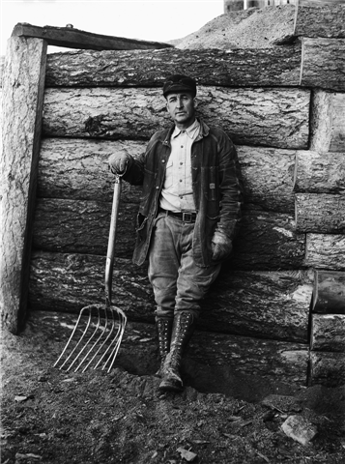
Work was a central theme of the FSA photographs since the agency sought to demonstrate that recipients of New Deal assistance were workers, not slackers. Mr. Bailey, with his boots, gloves, worn coat, patched pants, “True Temper” pitchfork, and resolute expression was a good advertisement of an FSA farmer.
John Vachon, Mr. Bailey, FSA Borrower, Flathead Valley, March 1942

Slide 21
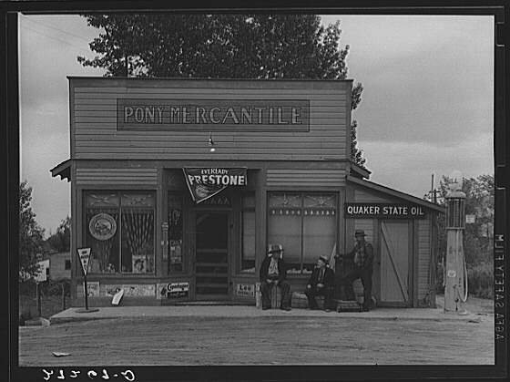
This photograph captures a moment in small town life as men seated on packing crates visited in front of the mercantile. The store sold necessities—Copenhagen tobacco and overalls—as well as luxuries: a bunch of bananas is just visible hanging inside the window.
Arthur Rothstein, The General Store, Pony, June 1939

Slide 22
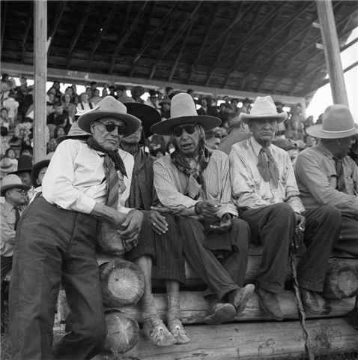
Inaugurated in 1904
to display the Crows’
agricultural produce,
over the years Crow Fair became a time for the Crows to gather together, to parade in elaborately beaded outfits, to dance, and to show their prowess in horse races and rodeos.
Marion Post Wolcott, Indians Watching Crow Fair, Crow Agency, August 1941

Slide 23
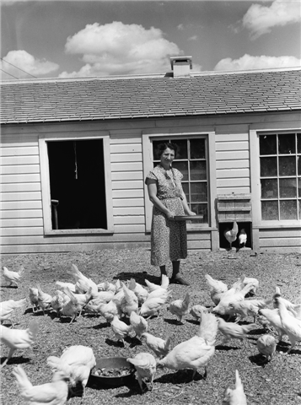
The FSA resettled drought-stricken farmers from eastern Montana onto irrigated homesteads in the Fairfield Bench Farms of Cascade and Teton counties.
Here a woman feeds white leghorns outside the new, modern chicken house. Egg and butter money often provided the only steady source of cash on many American farms.
Arthur Rothstein, Farm Wife Feeding her Chickens, Fairfield Bench Farms, May 1939

Slide 24
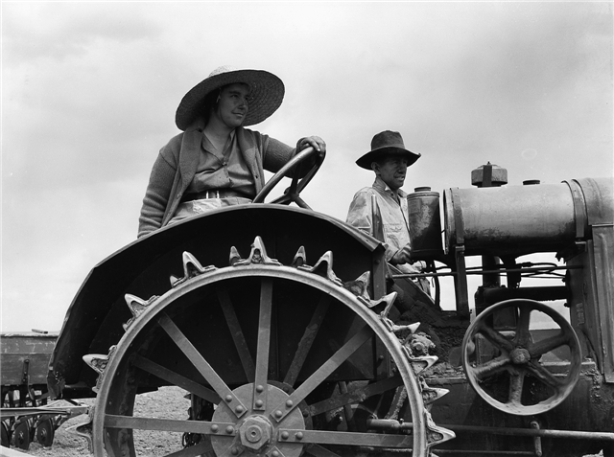
Farm mechanization increased during the Depression, with the FSA loaning money for tractors. By 1940, 47.6 percent of Montana farms used tractors although only 28 percent of the state’s farms had electricity.
Arthur Rothstein, A Farm Couple and Their International Harvester Tractor, Fairfield Bench Farms, May 1939

Slide 25
I know that you and I share an urge alike, that is, a desire to photograph the whole United States at once. Have a feeling that if we don't do it this year, it may blow away by next year.
—FSA Director Roy Stryker to photographer Russell Lee
Notes:
In addition to the economic programs through which the FSA provided relief to the nation’s farm families, the agency also operated a Historical Section, whose task was to create a body of photographs that would document conditions in rural America and drum up support for government programs designed to alleviate them.
Roy Stryker, a small firecracker of a man from Colorado, headed this effort. Stryker assembled a team of photographers that crisscrossed the country between 1935 and 1943 creating 77,000 images. One of the Section’s employees, Edwin Rosskam, gave the best description of the Section’s mission: "we had . . . a long look at the whole vast, complicated rural U.S. landscape with all that was built on it and all those who built and wrecked and worked in it and bore kids and dragged them up and played games and paraded and picnicked and suffered and died and were buried in it. That was our assignment.” The focus of the FSA photography project shifted over the course of the Depression. It began by documenting dust storms and rural poverty. In 1937 photographers increasingly turned their lenses on the farmers who had benefited from FSA programs and the small towns of America that Stryker believed formed the backbone of the country. Then in 1941, with U.S. entry into World War II, the project became part of the domestic propaganda machine, photographing America’s bounty harnessed for the war effort.
Montana’s FSA photos reflect all three phases of the FSA project: the early recording of rural poverty, the story of small-town America and government-assisted farms, and production for war.

Slide 26
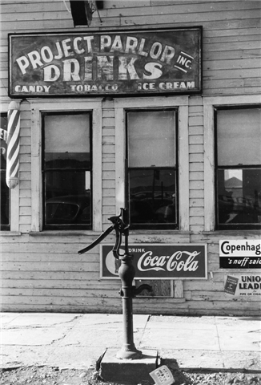
Seeking to document the traditional as well as the modern aspects of small American towns like Fairfield,
the photographer framed the water pump in front of the “Drink Coca-Cola” sign on the local pool parlor and barber shop.
Arthur Rothstein, Pool Parlor, Fairfield, May 1939

Slide 27
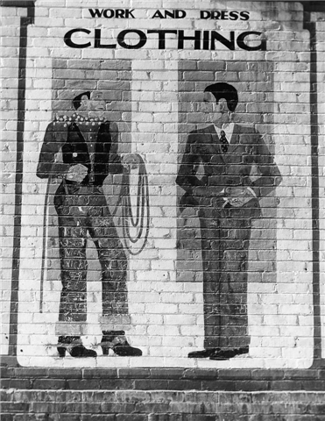
FSA photographers took hundreds of pictures of billboards and signs in order to capture the flavor of American culture in the 1930s and 1940s.
This whimsical painting portrays a man in town and country style. Interestingly, the cowboy’s jeans are more densely covered with graffiti than are the gentleman’s trousers.
John Vachon, Clothing Store Advertisement, Dillon, March 1942

Slide 28
Whenever they asked me, ‘What are you doing out here taking pictures?’ I said, ‘Well, I'm taking pictures of the history of today.’
—Russell Lee, FSA Photographer
Notes:
Between 1936 and 1942 four young FSA photographers worked in Montana:
Arthur Rothstein (1915–1985), Russell Lee (1903–1986), Marion Post Wolcott (1910-1990), and John Vachon (1914–1975). Rothstein, Lee, and Vachon became major twentieth-century American photographers; Wolcott married in 1941and, shortly after her work in Montana, she retired her cameras to raise a family. The four spent only a few months in the state, but they visited all its regions, and they explored Montana in every phase of the photography project’s life.
In 1936 Rothstein came in search of drought-driven farmers and starving cattle, and he returned in 1939 to see how conditions had changed. In 1937 Lee photographed poverty-stricken families in Sheridan County and returned in 1942 to document the copper industry in full wartime production. In 1941 Wolcott puzzled over how to convey the vistas of the Highline. And in 1942 Vachon went in search of shots illustrating the rejuvenation of spring, plentiful herds, and "Mrs. America," whom, FSA Director Roy Striker said, "is all over and often hard to find." Although none of the four had been to Montana before they came on assignment, instructions from Stryker and the popular culture of Westerns and cowboys had already shaped their ideas of the region.
All four photographers were struck by the beauty of the country, and all of them struggled with how to capture its grandeur and subtlety. Their photographs reveal that, even in the 1930s, Montana was seen as a quintessential western place.

Slide 29
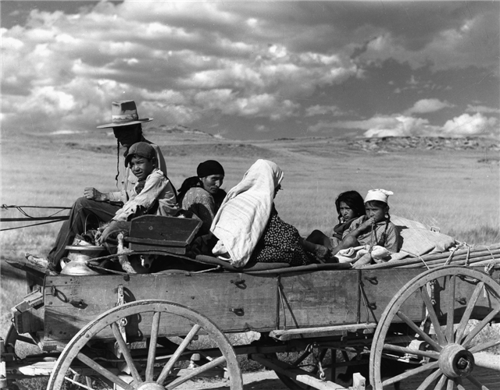
In 1941 Marion Post Wolcott accompanied a group of dudes from the Quarter Circle U ranch to Crow Fair. Her photos from that excursion are the only pictures of Indians taken by an FSA photographer in Montana.
Marion Post Wolcott, Indians Going to Crow Fair, Near Crow Agency, September 1941

Slide 30
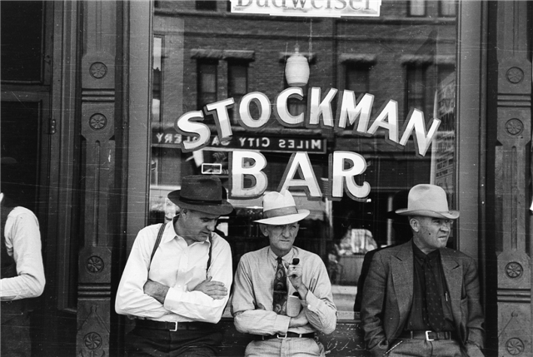
One of the main topics of the FSA photographers in
Montana was the cattle business. In this picture Arthur Rothstein extends the range of his assignment to include one of the many “Stockman” bars in Montana and the male visiting that took place in and outside of them.
Arthur Rothstein, Men in Front of the Stockman Bar on Main Street,
Miles City, June 1939

Slide 31
This Farm Security Administration was not an art project, it was an anti-art project, it was not the intention to produce pretty pictures. It was the intention to produce living documents which would prove to the citizens of the United States that a percentage of their fellow citizens, through no fault of their own, had no land to till, they had no way to live, not only because of the great depression, but also because of the dust bowl. However, out of that came some very great art.
—Beaumont Newhall, Photographer

Slide 32
I was a provincial New Yorker. I was born right in the middle of Manhattan . . . went to school in New York City and I even went to college in New York City. . . . It was a wonderful opportunity to be able to travel around the country and see what the rest of the United States was like.
—Arthur Rothstein, FSA Photographer

Slide 33
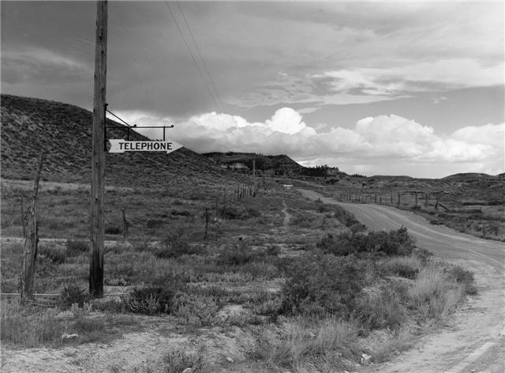
All the photographers commented on the isolation and distances of Montana. Arthur Rothstein once wrote to his boss: “The trouble with working out here is that you have to travel so far to get anywhere.“
Marion Post Wolcott, Sign at a Crossroads, Pointing to Nearest Telephone (near Birney), August 1941

Slide 34
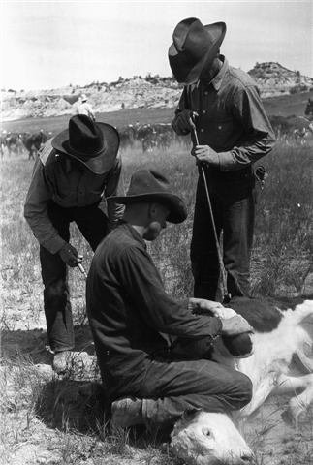
Like many ranches in Montana, the Quarter Circle U began taking in dudes in the 1920s to buffer the sagging cattle business. For many Montana ranches, dudes provided the means of preserving their stock-raising business. FSA photographers recorded both the work of cowboys and the play of dudes in the Treasure State.
Arthur Rothstein, Branding a Calf During the Roundup, Quarter Circle U Ranch, Rosebud County, June 1939

Slide 35
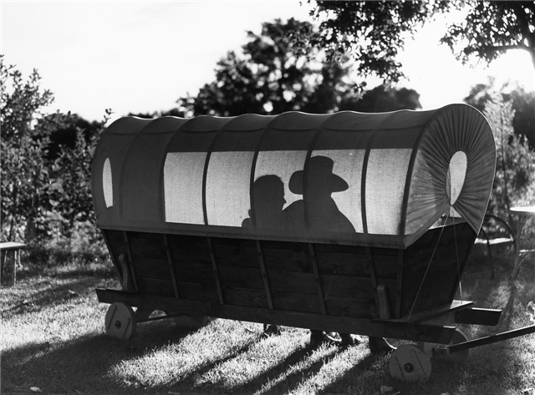
The romance of the West was one of the major sell-ing points of dude ranches in the 1920s and 1930s. As one guest at the Quarter Circle U reported, in addition to attending a rodeo and having a chance to participate in a roundup, “there were pretty girls to be talked with.”
Marion Post Wolcott, Dudes in a Covered Wagon Seat Quarter Circle U Ranch, Rosebud County, August 1941

Slide 36
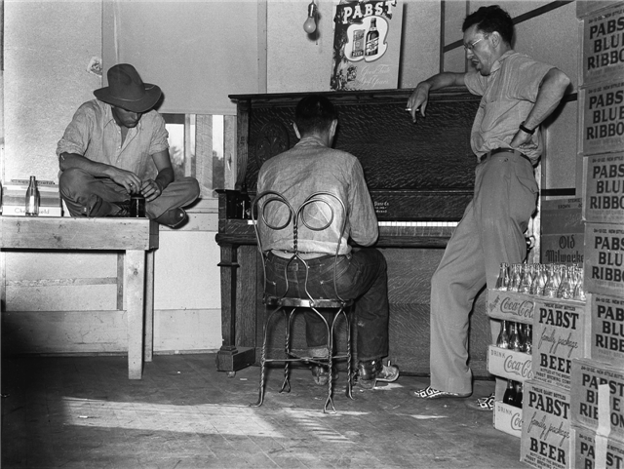
Prohibition was long gone when Arthur Rothstein visited Montana. Both he and fellow FSA photographer Marion Post Wolcott photographed dudes from the Quarter Circle U ranch drinking and dancing in a bar in nearby Birney.
Arthur Rothstein, Dudes Harmonizing in the Back Room of the Beer Parlor Birney, June 1939

Slide 37
I stop to take a picture of a guy along the road because he's wearing a big hat. —John Vachon, FSA Photographer
I ran into a ‘Go Western’ parade at Billings. People out here are becoming colorful and tough—the frontier spirit is rampant. Some of the men around here now use sulphuric acid as an after-shaving lotion and the rattlesnakes are all carrying anti-tetanus serum, just in case they might bite one of the local boys.—Arthur Rothstein, FSA Photographer
I worked very early in the morning, & very late a couple of evenings, too, trying to get the weird, strange, quality & feeling that a human sometimes has in seeing mountains & being ‘on top of the world’ & not exactly a part of it any more.—Marion Post Wolcott, FSA Photographer

Slide 38
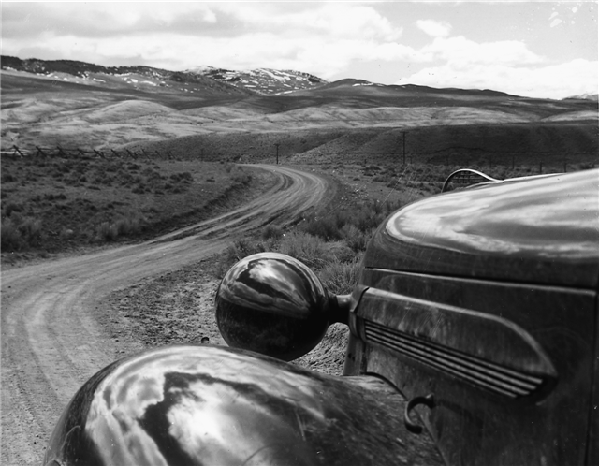
Vachon drove his Plymouth into Beaverhead County in the spring of 1942 with the assignment of photographing stock raising. After several days, he wrote to FSA Director Roy Stryker that he had found “the purest most undiluted West I've ever seen.”
John Vachon, Road into Bannack Beaverhead County, April 1942

Slide 39
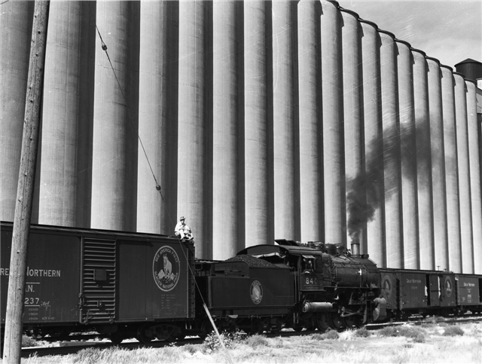
FSA photographers pictured all phases of grain production and shipment. Here a switchman perches above the Great Northern emblem that reads “See America First—Glacier National Park” in this photograph of a train and grain elevator in Great Falls.
Marion Post Wolcott, Grain Elevator and Great Northern Freight Train Great Falls, August 1941

Slide 40
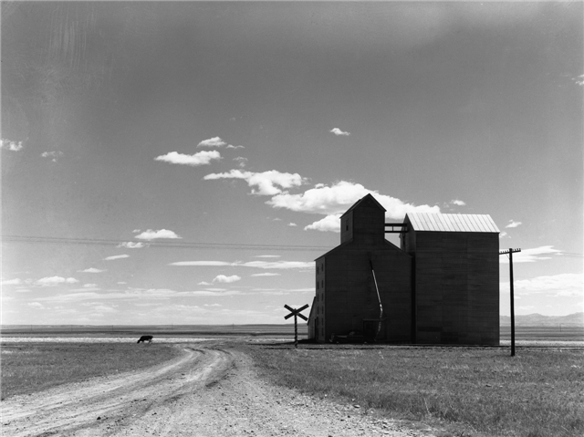
FSA photographers struggled to portray the vast expanses of Montana. Here, Arthur Rothstein used the grain elevator, railroad crossing sign, and lone cow to punctuate this scene of long land and big sky.
Arthur Rothstein, Grain Elevators on Sheffels’s Wheat Farm, Cascade County, May 1939

Slide 41
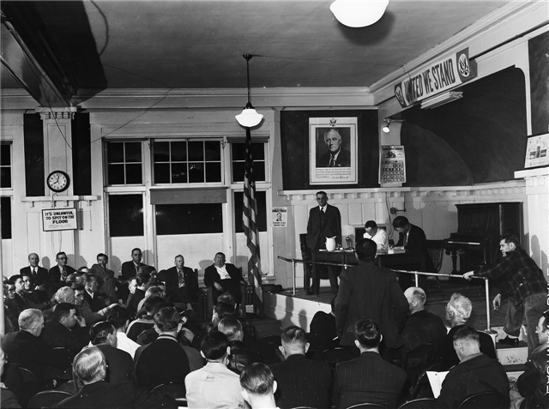
Butte miners had worked under an open shop for twenty years. With the support of the 1933 National Industrial Recovery Act, which gave workers the right “to organize and bargain collectively,” the miners reorganized the Butte Miners’ Union, Local No. 1 of the International Union of Mine, Mill, and Smelterworkers. Here they meet under the benevolent gaze of F.D.R.
Russell Lee, Miners’ Union Meeting, Butte, October 1942

Slide 42
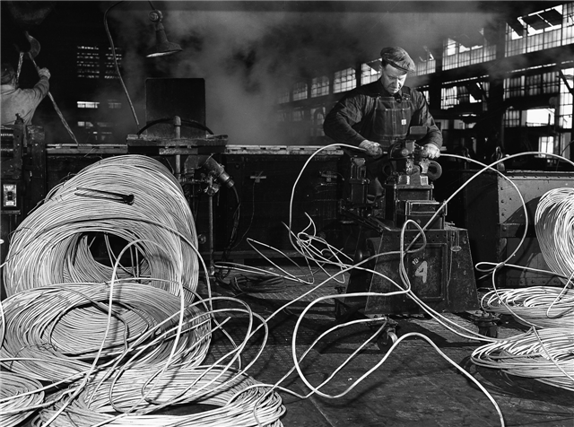
Producing goods for the war effort re-quired enormous amounts of electricity, and demand for copper wire for electrical transmission sky-rocketed. Copper towns, plagued with unemployment in the 1930s, begged for workers in the 1940s.
Russell Lee, Anaconda Wire and Cable Co., Great Falls,
September 1942

Slide 43
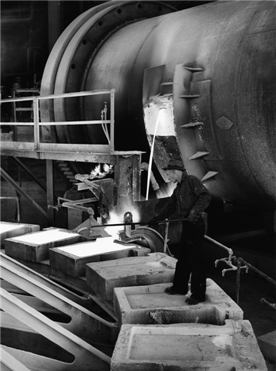
On assignment in 1942 to photograph Montana’s war-time copper production, Russell Lee took dozens of photographs of the copper industry back in full swing in Butte, Anaconda, and Great Falls. Here molten copper is cast into anodes, which would be shipped to Great Falls for refining.
Russell Lee, Anaconda Copper Mining Co. Smelter, Anaconda, September 1942

Slide 44
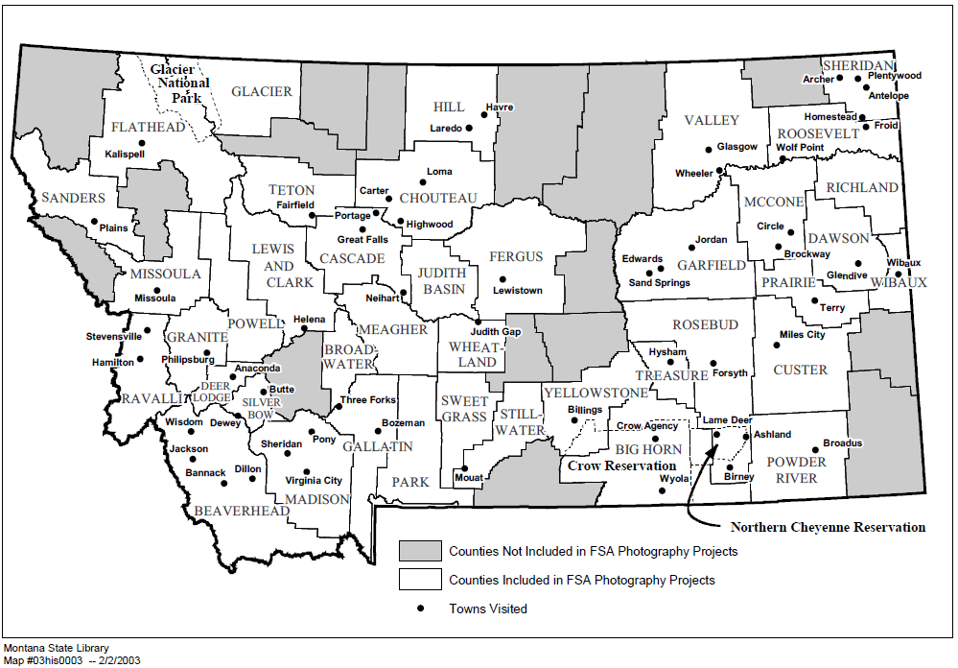
FSA photographers took pictures in more than 50 towns, in 40 of Montana’s 56 counties. Shown on the map are the communities in which they photographed. Most often they also photographed scenes of farms, ranches, and other rural locales as well. These sites are not located by name on the map, but every county visited is highlighted.

Slide 45
Places located on the map:
Beaverhead County – Bannack, Dewey, Dillon, Jackson, Wisdom
Big Horn County – Crow Agency, Wyola
Broadwater County
Cascade County – Great Falls, Neihart, Portage
Chouteau County – Carter, Highwood, Loma
Crow Indian Reservation
Custer County – Miles City
Dawson County – Glendive
Deer Lodge County – Anaconda
Fergus County – Lewistown
Flathead County – Glacier National Park, Kalispell
Gallatin County – Bozeman, Three Forks
Garfield County – Edwards, Jordan, Sand Springs
Glacier County
Glacier National Park
Granite County – Philipsburg
Hill County – Havre, Laredo
Judith Basin County Lewis and Clark County – Helena
Madison County – Pony, Sheridan, Virginia City
McCone County – Circle, Brockway

Slide 46
Places located on the map, cont.:
Meagher County
Missoula County – Missoula
Northern Cheyenne Indian Reservation
Park County
Powder River County – Broadus
Powell County
Prairie County – Terry
Ravalli County – Hamilton, Stevensville
Richland County
Roosevelt County – Froid, Wolf Point
Rosebud County – Ashland, Birney, Forsyth, Lame Deer
Sanders County – Plains
Sheridan County – Antelope, Archer, Homestead, Plentywood,
Silver Bow County – Butte
Stillwater County – Mouat
Sweet Grass County
Teton County – Fairfield
Treasure County – Hysham
Valley County – Glasgow, Wheeler
Wheatland County – Judith Gap
Wibaux County – Wibaux
Yellowstone County – Billings

