Slide 1

Hazel Hunkins: Billings Suffragist
Historic Case File 2 Documents

Slide 2
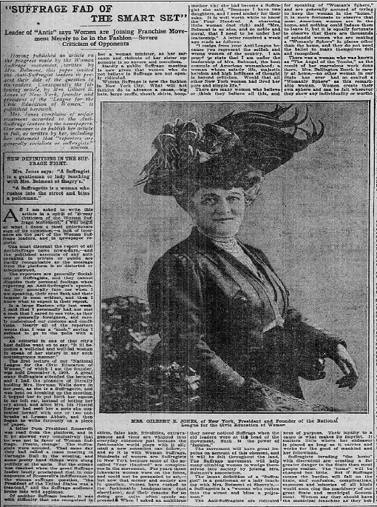
“Why We Don’t Want to Vote,” Woman’s Home Page, Bridgeport [Connecticut] Evening Farmer, April 30, 1910
The full page is available at http://chroniclingamerica.loc.gov/lccn/sn84022472/1910-04-30/ed-1/seq-8.pdf

Slide 3
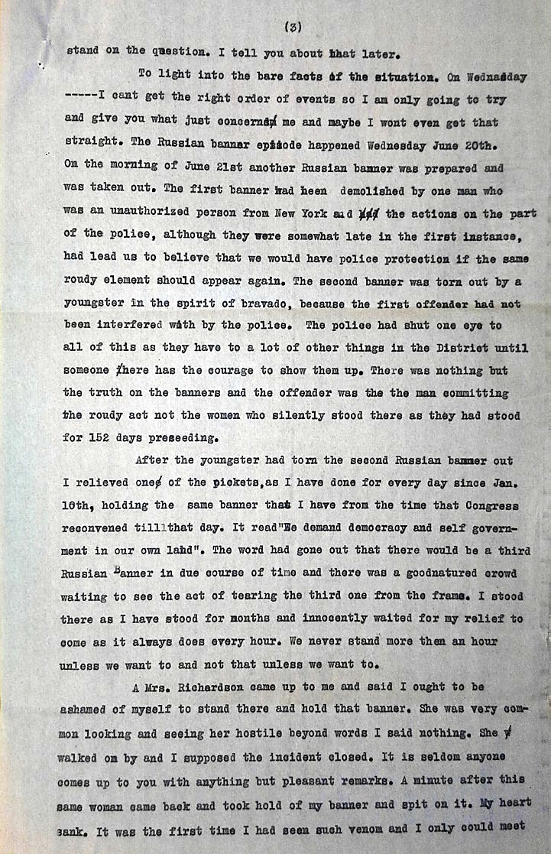
Typed letter:
Hazel Hunkins to Mother, July 8, 1917
(Page 3/6)
Source: Hazel Hunkins-Hallinan Papers, MC 532, box 61, folder 9, Schlesinger Library, Radcliffe Institute

Slide 4
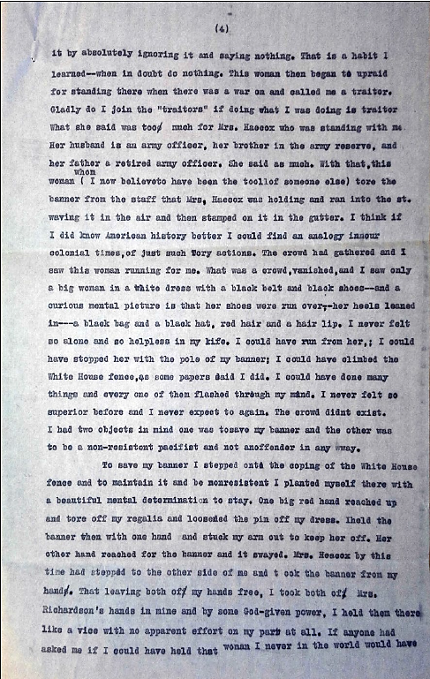
Typed letter:
Hazel Hunkins to Mother, July 8, 1917
(Page 4/6)
Source: Hazel Hunkins-Hallinan Papers, MC 532, box 61, folder 9, Schlesinger Library, Radcliffe Institute

Slide 5
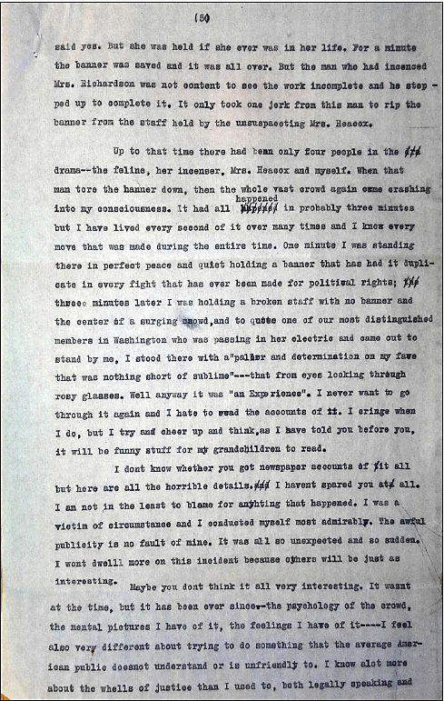
Typed letter:
Hazel Hunkins to Mother, July 8, 1917
(Page 5/6)
Source: Hazel Hunkins-Hallinan Papers, MC 532, box 61, folder 9, Schlesinger Library, Radcliffe Institute

Slide 6
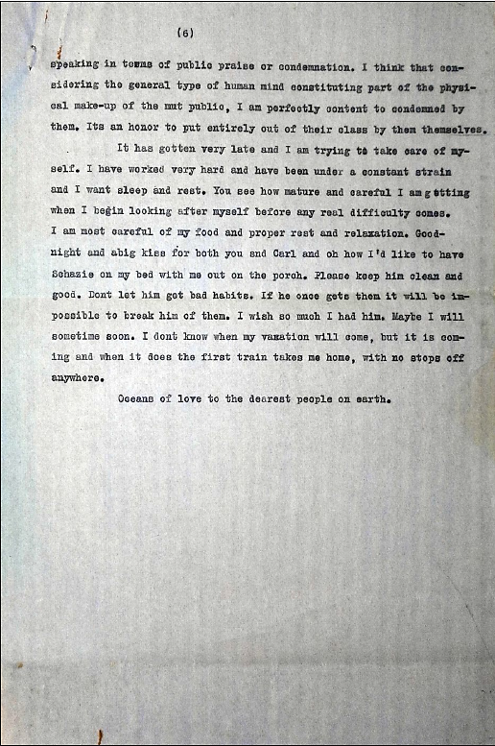
Typed letter:
Hazel Hunkins to Mother, July 8, 1917
(Page 6/6)
Source: Hazel Hunkins-Hallinan Papers, MC 532, box 61, folder 9, Schlesinger Library, Radcliffe Institute

Slide 7
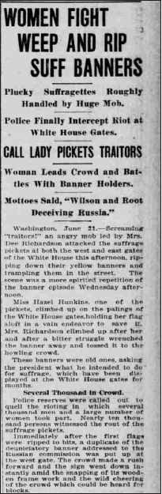
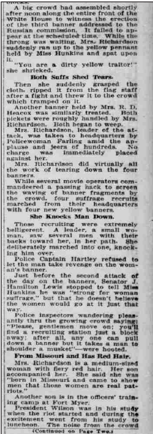
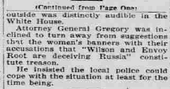
“Women Fight, Weep, and Rip Suff Banners,” Topeka [Kansas] State Journal, June 21, 1917
The full page is available at http://chroniclingamerica.loc.gov/lccn/sn82016014/1917-06-21/ed-1/seq-1.pdf and http://chroniclingamerica.loc.gov/lccn/sn82016014/1917-06-21/ed-1/seq-2.pdf

Slide 8
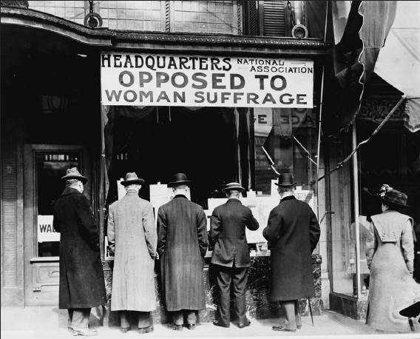
“National Anti-Suffrage Association,” c. 1911, Harris and Ewing, photographer
Source: Harris & Ewing Collection, Library of Congress Prints and Photographs Division, Washington, D.C. LC-USZ62-25338

Slide 9
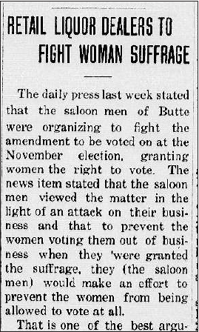
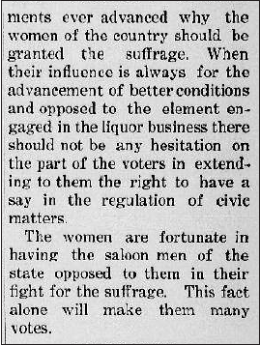
“Retail Liquor Dealers to Fight Woman Suffrage,” Ronan Pioneer, March 6, 1914 (Column 5)
The full page is available at http://chroniclingamerica.loc.gov/lccn/sn86075298/1914-03-06/ed-1/seq-1.pdf

Slide 10

For the accompanying lesson plan
and more information, visit: http://mhs.mt.gov/education/women/HazelHunkins
Montana Historical Society
Outreach and Interpretation Program
P.O. Box 201201, Helena, MT 59620
406-444-4740
Notes:
Logo and ADA revisions added 12/2025

