Slide 1

Hazel Hunkins:
Billings Suffragist
Historic Case File 3 Documents

Slide 2
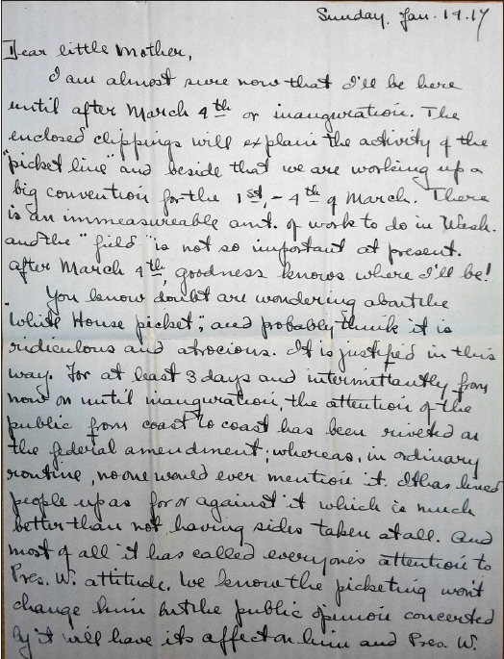
Handwritten letter:
Hazel Hunkins to Mother, January 1917
(Page 1/3)
Source: MC 532, box 80. folder 1, Schlesinger Library, Radcliffe Institute

Slide 3
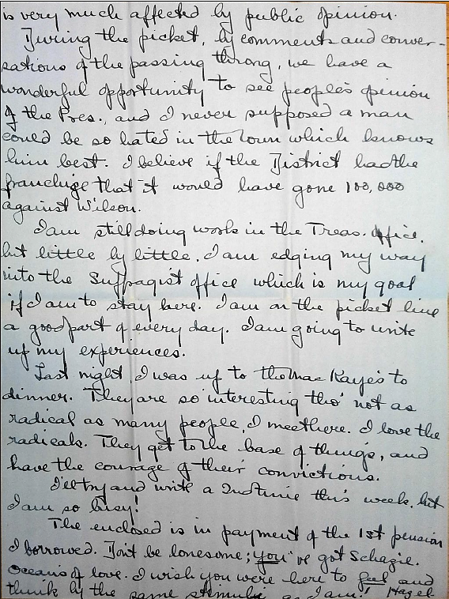
Handwritten letter:
Hazel Hunkins to Mother, January 1917.
(Page 2/3)
Source: MC 532, box 80,
folder 1, Schlesinger Library, Radcliffe Institute

Slide 4
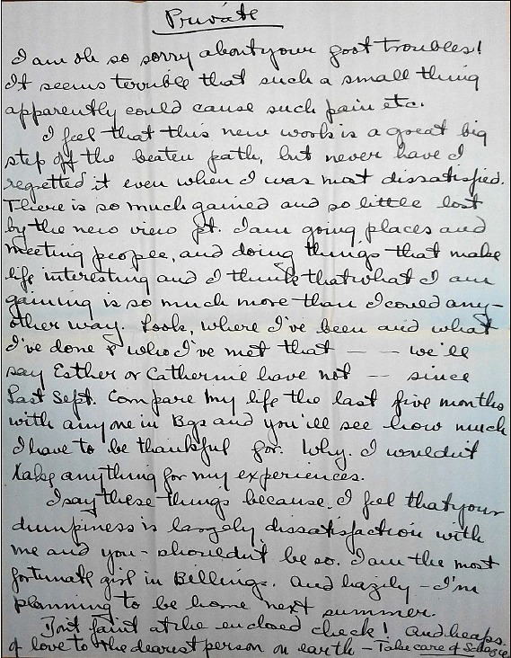
Handwritten letter:
Hazel Hunkins to Mother, January 1917.
(Page 3/3)
Source: MC 532, box 80. folder 1, Schlesinger Library, Radcliffe Institute

Slide 5
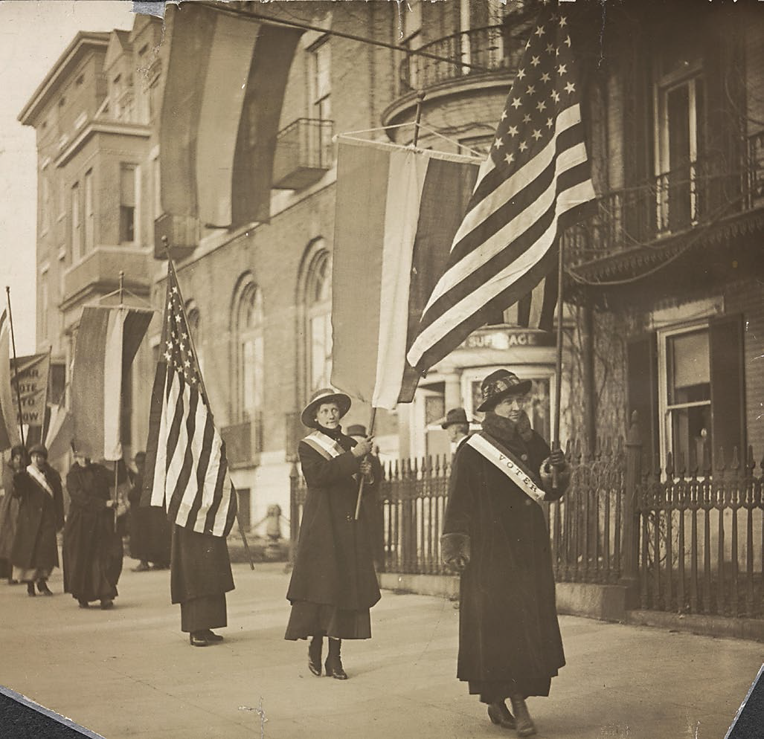
“Women Voters Day on the Picket Line,” February 14, 1917.
Source: National Woman’s Party Records, Group I, Container I:160, Folder: Pickets, 1917, Library of Congress Prints and Photographs Division, Washington, D.C.

Slide 6
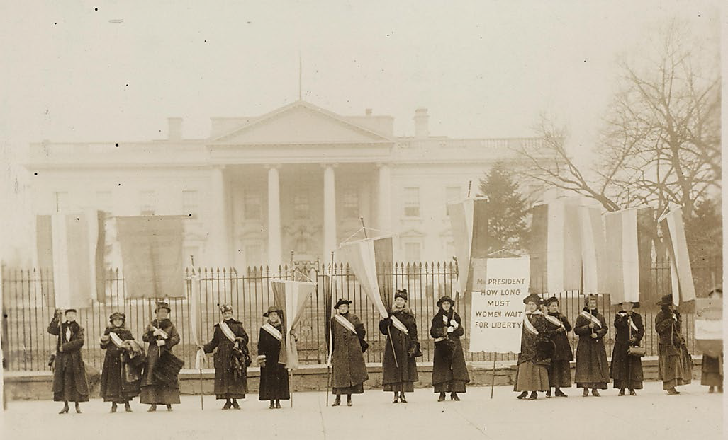
“Penn[sylvania] on the Picket Line,” 1917, Harris and Ewing, photographer.
Source: Harris & Ewing Collection, Prints and Photographs Division, Washington, D.C. http://www.loc.gov/item/mnwp000212/

Slide 7
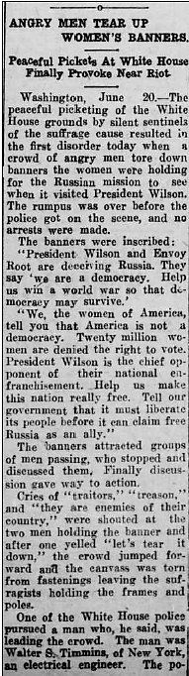
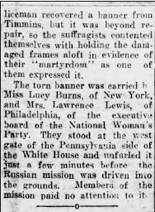
“Angry Men Tear Up Women’s Banners,” New Iberia [Louisiana] Enterprise, June 23, 1917
The full page is available at http://chroniclingamerica.loc.gov/lccn/sn88064328/1917-06-23/ed-1/seq-1.pdf

Slide 8
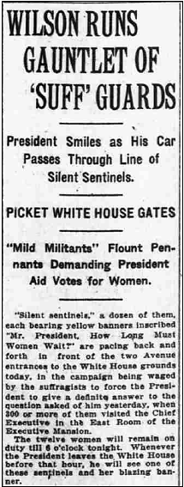
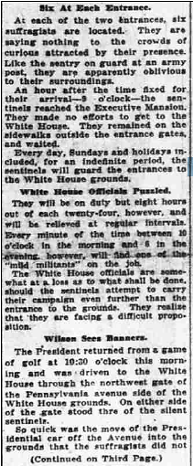
“Wilson Runs Gauntlet of ‘Suff’ Guards”, Washington [D.C.] Times, January 10, 1917, p. 1.
The full page is available at http://chroniclingamerica.loc.gov/lccn/sn84026749/1917-01-10/ anded-1/seq-1.pdf

Slide 9
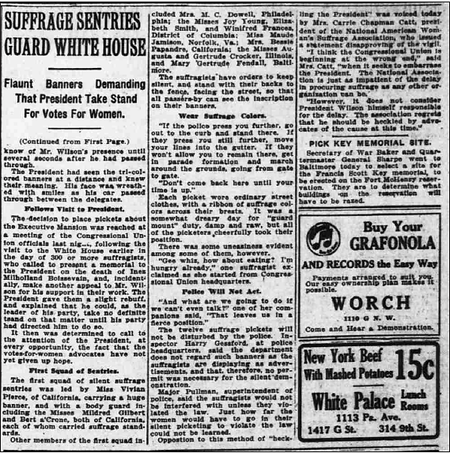
“Wilson Runs Gauntlet of ‘Suff’ Guards”, Washington [D.C.] Times, January 10, 1917, p. 3.
The full page is available at http://chroniclingamerica.loc.gov/lccn/sn84026749/1917-01-10/ed-1/seq-3.pdf

Slide 10

Montana Historical Society
Outreach and Interpretation Program
P.O. Box 201201, Helena, MT 59620
406-444-4740
For the accompanying lesson plan
and more information, visit: http://mhs.mt.gov/education/women/HazelHunkins
Notes:
Logo and ADA revisions added 12/2025

