Slide 1

Hazel Hunkins: Billings Suffragist
Historic Case File 4 Documents

Slide 2
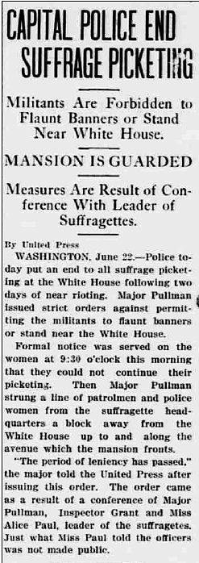
“Capital Police End Suffrage Picketing,” Daily Missourian [Columbia, MO], June 22, 1917
The full page is available at http://chroniclingamerica.loc.gov/lccn/sn89066314/1917-06-22/ed-1/seq-1.pdf

Slide 3
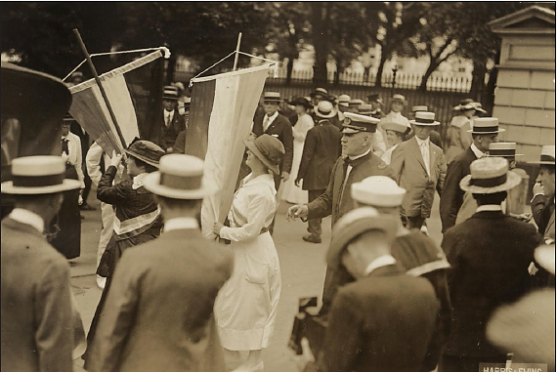
“Police Arresting Picketers Outside White House,” August 1918
Source: Harris and Ewing, photographer. Harris & Ewing Collection, Library of Congress Prints and Photographs Division, Washington, D.C.

Slide 4
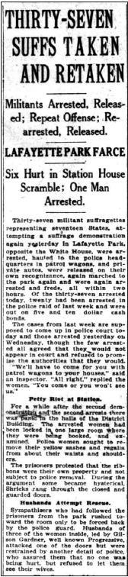
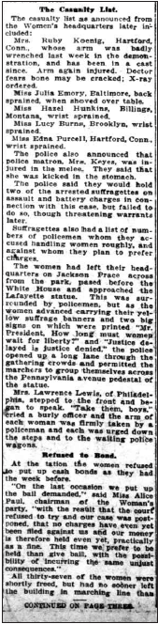
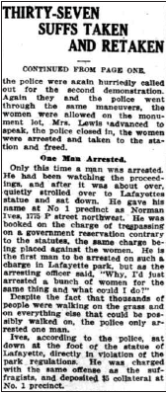
“Thirty-Seven Suffs Taken and Retaken,” Washington [D.C.] Herald, August 13, 1918
The full page is available at http://chroniclingamerica.loc.gov/lccn/sn83045433/1918-08-13/ed-1/seq-1.pdf and http://chroniclingamerica.loc.gov/lccn/sn83045433/1918-08-13/ed-1/seq-3.pdf

Slide 5
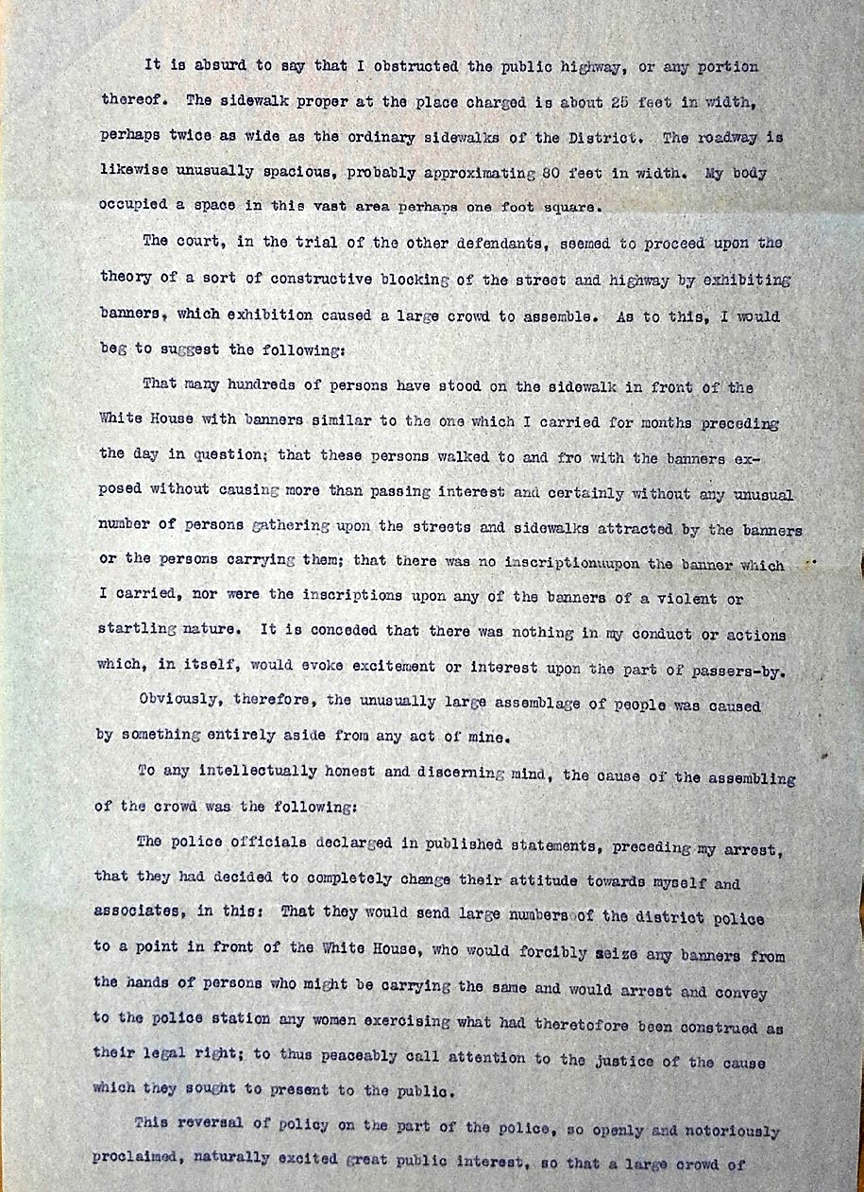
Hazel Hunkins’ typed response to court charges.
(Page 1/2)
Source: Hazel Hunkins-Hallinan Papers, MC 532, box 61, folder 9, Schlesinger Library, Radcliffe Institute

Slide 6
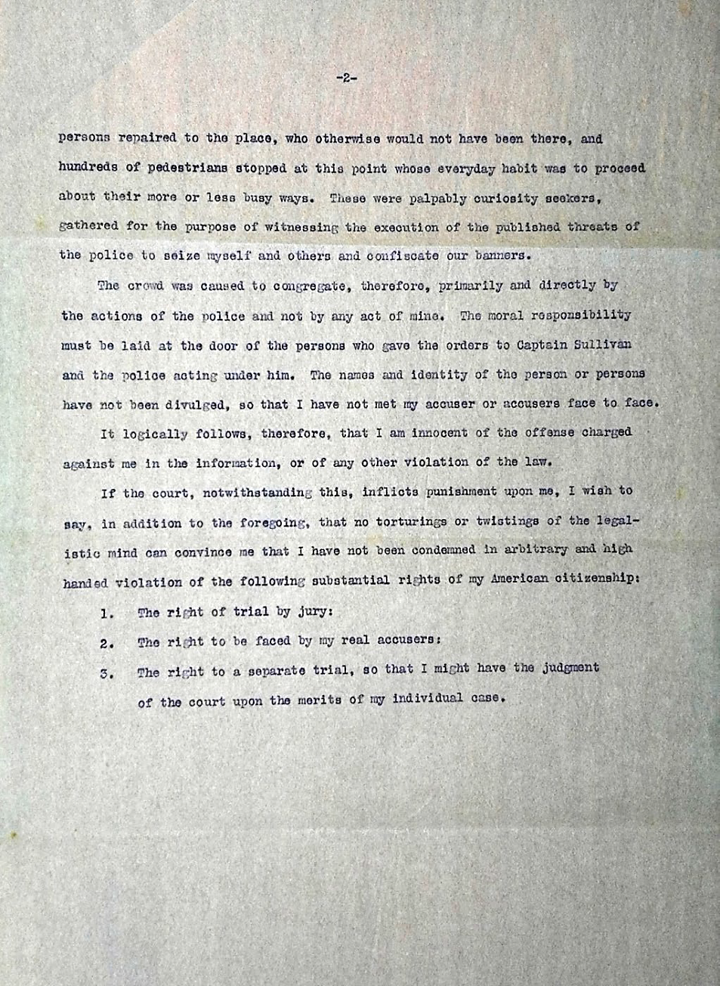
Hazel Hunkins’ typed response to court charges.
(Page 2/2)
Source: Hazel Hunkins-Hallinan Papers, MC 532, box 61, folder 9, Schlesinger Library, Radcliffe Institute

Slide 7

Montana Historical Society
Outreach and Education Program
P.O. Box 201201, Helena, MT 59620
406-444-4740
For the accompanying lesson plan
and more information, visit: http://mhs.mt.gov/education/women/HazelHunkins
Notes:
Logo and ADA revisions added 12/2025

