Slide 1

Hazel Hunkins Billings Suffragist
Images to Project for Part 1 of the Lesson Plan

Slide 2

Visit MTHS Website for more info
For the accompanying lesson plan
and more information, visit: http://mhs.mt.gov/education/women/HazelHunkins
http://mhs.mt.gov/education/women/HazelHunkins
Montana Historical Society
Outreach and Interpretation Program
P.O. Box 201201, Helena, MT 59620
406-444-4740
Notes:
ADA Revision and Logo 10/8/2025

Slide 3
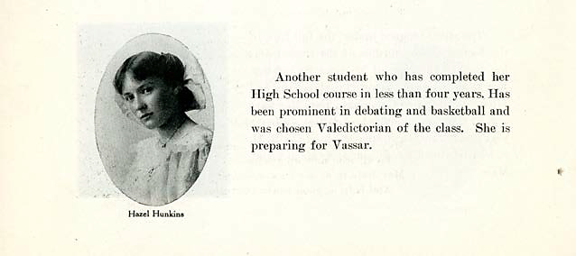
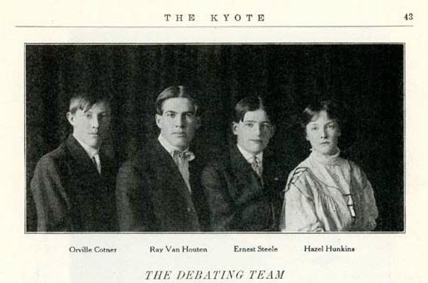
Hazel Hunkins and Students
Notes:
Photos from the 1908 Kyote Annual (Billings, Montana, High School)

Slide 4
Questions and Corroboration
Title of Document: Photos from the 1908 Kyote Annual (Billings, Montana, High School)
Creator: Billings High School
Date Created: 1908
Content: Yearbook photos of Hazel Hunkins. In one she wears a dress with a lace collar and brooch—and a bow in her hair. Her hair is long and she looks “old-fashioned.” In the second photo (of the debate team), three boys are in suits; Hazel has a light-colored and very loose-fitting top with a high collar. She is the only girl on the team. Text says that she completed high school requirements in less than 3 years, and participated in debate and basketball. Class Valedictorian, college she planned to attend – Vassar.
Subtext:
How close to the event depicted was the source created (both time and place)? Immediate
Why was the item created? What was its purpose? To acknowledge student accomplishments and preserve memories.
Who was the intended audience? Students, staff, family, community.
Does this document exhibit a point of view or bias? The editors/school decided what was worth including and what wasn’t.
Context: What events were occurring during the time period the document was created? How might this have influenced the source?
Progressive Era—time of active political and social reforms (possibly made Hazel interested in debate).
Homesteading boom in Montana—Billings is growing.
Question: Write at least one question you have after investigating this source. What are you confused about? What new questions does this source raise?
How common was it for girls to debate and play basketball?
How common was it for girls of this era to go to high school and college?
Corroboration (Complete after reading the other documents in the case file)

Slide 5
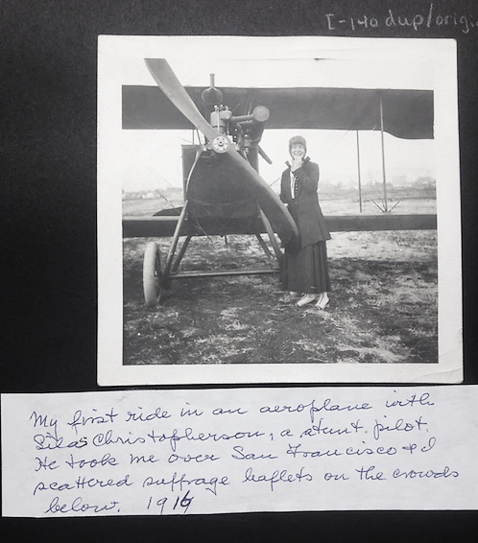
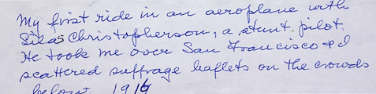
Hazel Hunkins after an aeroplane ride
Notes:
Text reads: My first ride in an aeroplane with Silas Christopherson; a stunt pilot. He took me over San Francisco and I scattered suffrage leaflets on the crowds below. 1916
Source: Hazel Hunkins-Hallinan Papers, MC 532, Schlesinger Library, Radcliffe Institute

Slide 6
Content and subtext
Title of Document: Photo of Hazel by Biplane
Creator: Unknown Photographer
Date Created: 1916
Content: Biplane, woman standing near propeller, wearing high button shoes, dark ankle-length skirt with matching coat, and close-fitting hat. You can’t see her hair. The plane is on dirt and brush. The caption states she dropped suffrage literature over San Francisco and her pilot was Silas Christofferson, stunt pilot.
Subtext:
How close to the event depicted was the source created (both time and place?) The photo was probably immediate. The caption was probably done later. Note changing the 7 to a 6. (Christofferson died in a plane crash Oct 31, 1916)
Why was the item created? What was its purpose? Photo was possibly taken for suffrage PR. The scrapbook could have been created for personal use (to document life) or for organizational use (to document suffrage movement).
Who was the intended audience? Personal, family, public—future historians.
Does this document exhibit a point of view or bias? No.
Context:: What events were occurring during the time period the document was created? How might this have influenced the source?
1903 (13 years earlier) Wilbur and Orville Wright make first flight.
1914 The first commercial flight takes place.
1916
Woodrow Wilson elected as president.
Jeannette Rankin elected from Montana as first woman to Congress.
Women have the vote in 11 states, including California.
Question: Write at least one question you have after investigating this source. What are you confused about? What new questions does this source raise?
How common were airplanes?
Was this type of leaflet drop common? Was it effective?
If women could already vote in California, why was Hazel Hunkins leafleting there?
Corroboration (Complete after reading the other documents in the case file)
Notes:
What was

Slide 7
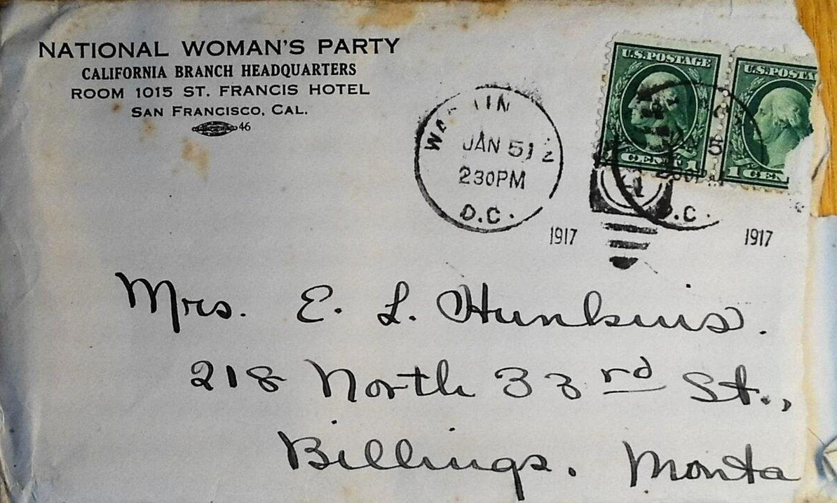
Envelope
Notes:
Envelope, Hazel Hunkins-Hallinan Papers, MC 532, box 80, folder 1, Schlesinger Library, Radcliffe Institute

Slide 8
Content and Subtext
1917
January 10, the National Woman’s Party begins posting “Silent Sentinels” in front of the White House. (The start of picketing may have brought Hazel Hunkins to D.C. from California.)
April 2, Woodrow Wilson asks Congress to declare war on Germany.
1918
US Post Office begins offering “air mail.”
Question: Write at least one question you have after investigating this source. What are you confused about? What new questions does this source raise?
Why is the stationery from San Francisco when the letter was mailed from D.C.?
How long did it take a letter to get from D.C. to Montana? Were there faster ways of communicating?
Corroboration (Complete after reading the other documents in the case file):
The caption on the airplane picture notes location as San Fransisco, 1916. Return address on envelope is San Fransisco, but the postmark is D.C., January 1917.
Title of Document: Envelope
Creator: Hazel Hunkins
Date Created: Jan 5, 1917
Content: Two green, one-cent US postage stamps, one torn. The return address reads “National Women’s Party, California’s Branch Headquarters, Room 1015 St Francis Hotel, San Francisco, CA [Logo and #16],” Two postmarks: one unreadable, and the other shows Washington, DC Jan 5 (?) 2:30 below stamps the year 1917 appears twice. Addressed to: Mrs. E. L. Hunkins, 218 North Billings, MT. The right edge of the envelope is torn.
Subtext:
How close to the event depicted was the source created (both time and place?) Immediate – envelope return address is different from postmark [where envelope mailed]
Why was the item created? What was its purpose? To direct a letter to E.L Hunkins (family member?)
Who was the intended audience? Post office personnel, the person receiving the letter.
Does this document exhibit a point of view or bias? No.
Context: What events were occurring during the time period the document was created? How might this have influenced the source?
Notes:
What was

Slide 9
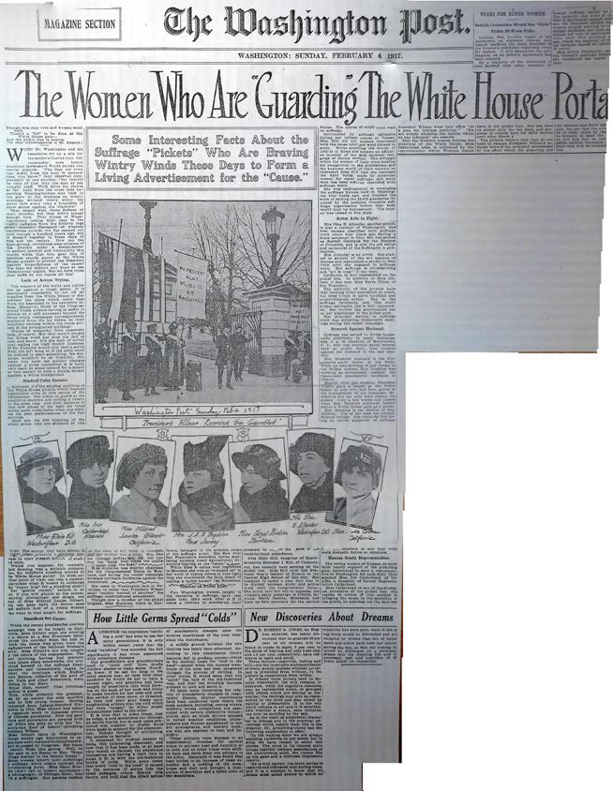
The Women Who are guarding the white house portal
See next slide for excerpt from article
Notes:
“The Women Who Are Guarding the White House Portal,” Washington Post clipping, February 4, 1915, Hazel Hunkins-Hallinan Papers, MC 532, box 61, folder 10, Schlesinger Library, Radcliffe Institute

Slide 10
Excerpt from “The women who are guarding the white house portal.”
Excerpt from “The Women Who Are ‘Guarding’ the White House Portals,” Magazine Section, The Washington Post, February 4, 1917
“Some women inherit their sufferings for suffrage, while others contract the all-consuming fever. Miss Hazel Hunkins (don’t fail to inspect accompanying photograph), of Billings, Mont., was born a suffragist. Her parents resided at the time of her birth in Colorado and her mother was a voter. She, like the Chicago suffragists, will tell you that the “hand that rocks the cradle will never rock the boat.” Miss Hunkins was district chairman for the Congressional Union in Montana, and during the recent campaign stumped northern California against the Democrats. She came to Washington late in November to insist that President Wilson shall “mother instead of smother” the suffrage constitutional amendment. Though now a member of the picket brigade, Miss Hunkins, while in California, belonged to the aviation corps of the suffrage army. She flew over San Francisco’s suburban towns scattering burning (used figuratively) literature bearing on the “cause.” While Miss Hunkins was registered in Montana she was so wrapped up in her work of urging others to vote right that she overlooked the little detail of casting a ballot herself last November....”

Slide 11
Content and subtext of document
Title of Document: Women Who Are Guarding the White House Portal
Creator: Washington Post
Date Created: February 4, 1917
Content: Newspaper feature article talking about why the suffragists were picketing the White House. Includes photos and Insert photos of some of the picketers.
Subtext:
How close to the event depicted was the source created (both time and place?) Immediate
Why was the item created? What was its purpose? To help sell newspapers and keep subscribers, to report the news and entertain readers (human interest story). The suffragists used this form of media to gain attention and support for their cause.
Who was the intended audience? D.C. area newspaper readers
Does this document exhibit a point of view or bias? Yes. The tone is patronizing, for example “dear old suffs.” However, it does included some phrases that seem to express admiration (for example, “staying power”).
Context: What events were occurring during the time period the document was created? How might this have influenced the source?
1917
January 10, the National Woman’s Party begins posting “Silent Sentinels” in front of the White House.
April 2, Woodrow Wilson asks Congress to declare war on Germany (article might not be so favorable of the suffragists if it were written after war was declared).
November 14, Night of Terror: The Supt. of the Occoquan Workhouse orders guards to brutalize the suffragist inmates.
Question: Write at least one question you have after investigating this source. What are you confused about? What new questions does this source raise?
Why did newspaper article report that Hunkins didn’t vote? How embarrassing was that to suffrage cause?
Was suffrage primarily a symbol of equality for Hunkins or did she really want to vote?
Did the article’s author/Washington Post support or oppose woman’s suffrage?
Corroboration (Complete after reading the other documents in the case file)
Notes:
What was

Slide 12
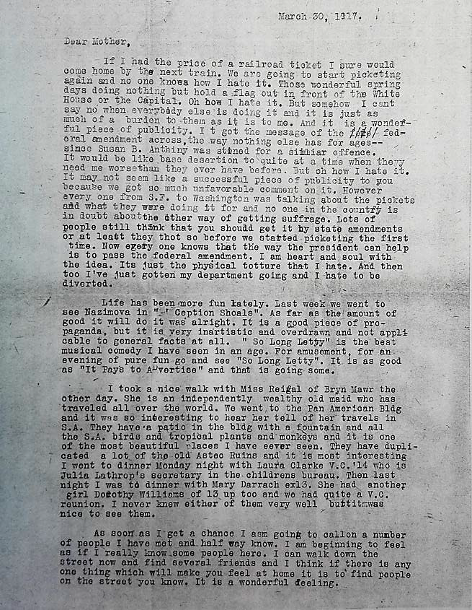
Hazel Hunkins to mother
Notes:
Hazel Hunkins to Mother, March 30, 1917, Hazel Hunkins-Hallinan Papers, MC 532, box 80, folder 1, Schlesinger Library, Radcliffe Institute

Slide 13
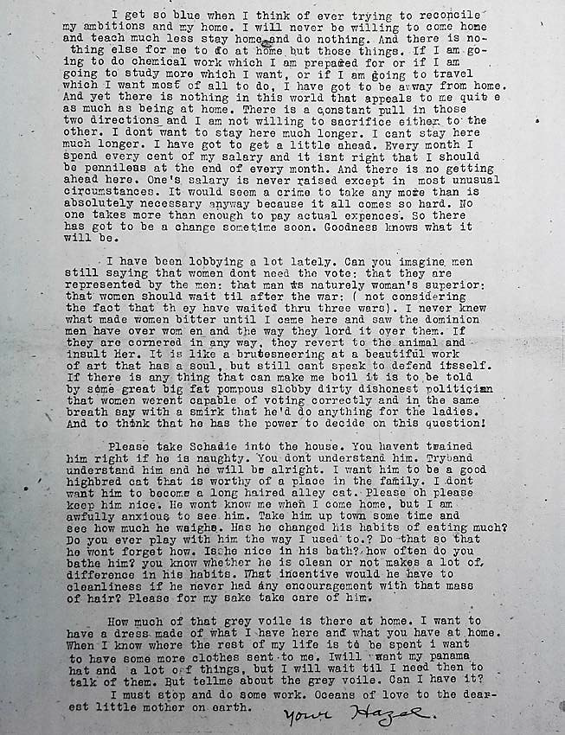
Letter from Hazel Hunkins to mother

Slide 14
Contextualizing hazel’s letter
Title of Document: Letter to Mother
Creator: Hazel Hunkins
Date Created: March 30, 1917
Content: In a letter to her mother, Hazel talks about her feelings concerning the picketing by suffragists, seeing friends from Vassar college and new acquaintances, and what she was doing for entertainment. She discusses her frustrations with life as a suffragist. She is worried about finances and her future. She wants to be home, but is enjoying the excitement of life in Washington, D.C. She makes observations about politicians she has been lobbying. She talks about clothes and fabric. She is also worried about her pet cat; she wants her mother to take good care of it.
Subtext:
How close to the event depicted was the source created (both time and place?) Immediate
Why was the item created? What was its purpose? To keep in touch with her mother what she was doing and find emotional support.
Who was the intended audience? Hazel’s mother.
Does this document exhibit a point of view or bias? Yes. Hazel’s perspective is that of someone directly involved in the movement and a “true believer.”
Context: What events were occurring during the time period the document was created? How might this have influenced the source?
1917
“So Long Letty” was being performed at the Shubert Theater October 1916-January 1917.
January 10, the NWP begins posting “Silent Sentinels” (so Hazel has been picketing for three months).
March 4, Woodrow Wilson begins his second term.
April 2, Woodrow Wilson asks Congress to declare war on Germany.
November 6, New York passes woman’s suffrage, a victory for the NAWSA’s “winning plan.”
Question: Write at least one question you have after investigating this source. What are you confused about? What new questions does this source raise?
How often did Hazel Hunkins write her mother? What other ways was she able to connect with her?
Did other picketers share her feelings about picketing?
Corroboration (Complete after reading the other documents in the case file):
The newspaper article corroborates that Hunkins is one of the picket.
Both the letter and newspaper talk about the difficulty of standing still.
Notes:
What was

Slide 15
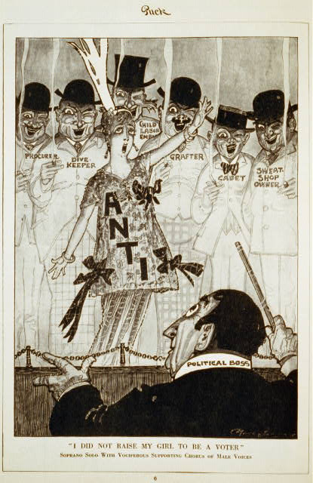
“I did not raise my girl to be a voter”
Notes:
“I Did Not Raise My Girl to Be a Voter.” Political cartoon published in Puck [magazine], October 9, 1915, p. 6. Image from Library of Congress Prints and Photographs Division Washington, D.C.

Slide 16
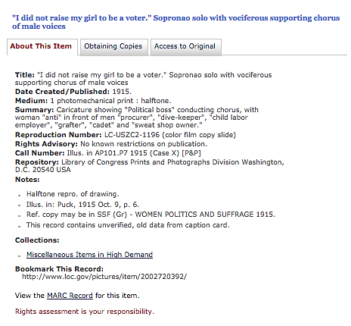
“I did not raise my girl to be a voter” Continued
Title
Date
Summary
Bookmark

Slide 17
Context and subtext of document
Title of Document: “I Did not raise my girl to be a voter.” Soprano Solo with vociferous male voices.
Creator: Puck Magazine
Date Created: Published October 9, 1915
Content: Political Cartoon – Caricature showing “Political boss” conducting chorus, with woman “anti” in front of men “procurer”, “dive-keeper”, “child labor employer”, “grafter”, “cadet” and “sweat shop owner.”
“Procurer” and “cadet” are synonyms for pimp.
“Dive-keeper” is a slumlord.
“Grafter” is a corrupt politician who accepts bribes.
Subtext:
How close to the event depicted was the source created (both time and place?) During the suffrage debate.
Why was the item created? What was its purpose? To educate and entertain readers of Puck, the first humor magazine in the US (1871-1918), and to support woman’s suffrage.
Who was the intended audience? Working and middle-class readers nationwide.
Does this document exhibit a point of view or bias? Yes. This pro-suffrage cartoon ties the opposition to vice, greed, exploitation, and corruption.
Context: What events were occurring during the time period the document was created? How might this have influenced the source?
Progressive Era—height of “muckracking” press.
1911:
National Association Opposed to Woman Suffrage formed.
Triangle Shirtwaist Factory Fire kills 146 garment workers.
1914:
The National Federation of Women’s Clubs formally endorses the suffrage campaign.
Question Write at least one question you have after investigating this source. What are you confused about? What new questions does this source raise?
Why did the cartoonist think political bosses, pimps, slumlords, grafters, sweatshop owners, and child labor employees oppose woman’s suffrage? Did they really?
Were these the only type of people who opposed woman’s suffrage?
Corroboration (Complete after reading the other documents in the case file):
In her letter, Hunkins discusses antis she meets while lobbying. She calls them “dishonest” politicians—but the reasons they give for opposing woman’s suffrage are principled: “man is naturally woman’s superior.”

