Slide 1
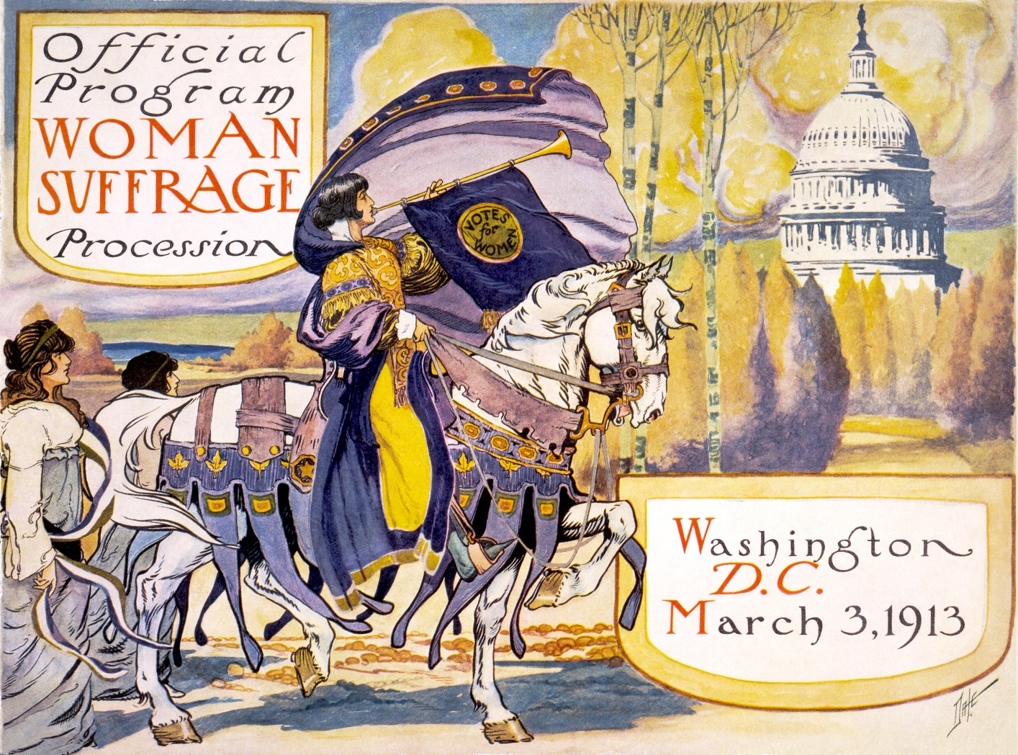
The Long Road to Woman’s Suffrage

Slide 2
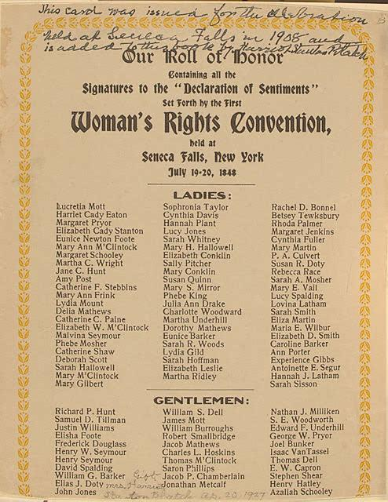
The 1848 Seneca Falls Convention
Organized by Elizabeth Cady Stanton.
Approximately 300 people attend; 2/3 are women and most are abolitionists.
Resulted in the “Declaration of Sentiments, Grievances, and Resolutions”—100 attendees sign.
Declaration of Sentiments modeled on the Declaration of Independence: “We hold these truths to be self-evident: that all men and women are created equal.”
Argued for child custody rights, property rights, rights to education.
And—most controversially—the right to vote.
Handbill, 1848
Source: Library of Congress

Slide 3
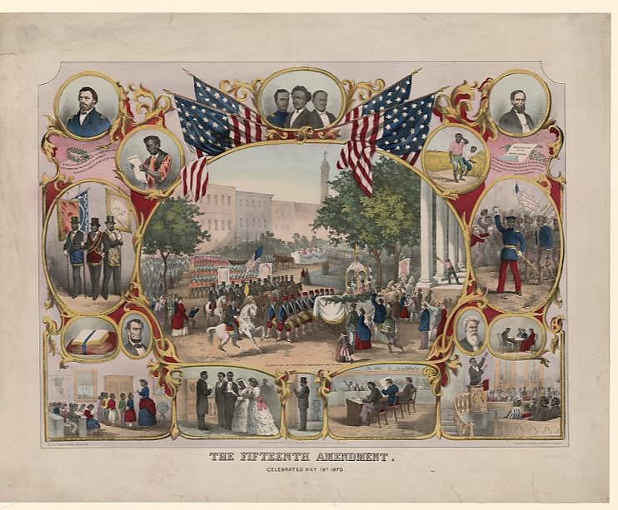
After the Civil War
The suffrage movement split over whether to support the Fifteenth Amendment (which gave the right to vote to African American men.)
Engraving by James C. Beard, ca. 1871
Source: Library of Congress

Slide 4
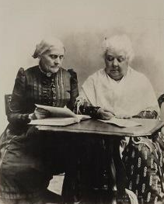
National Woman
Suffrage Association
1869 Elizabeth Cady Stanton and Susan B. Anthony created the National Woman Suffrage Association (NWSA).
  Opposed the Fifteenth Amendment because it did not include women.
  Worked to change federal law.
Susan B. Anthony (L) and Elizabeth Cady
Stanton (R), Source: Library of Congress

Slide 5
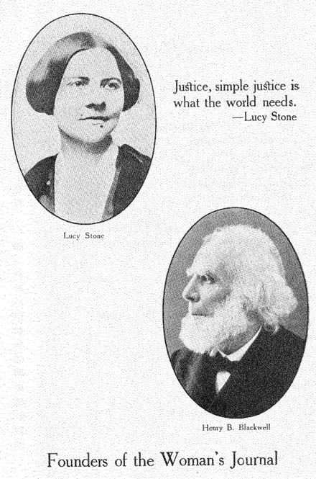
American Woman
Suffrage Association
Lucy Stone and other abolitionists formed the American Woman Suffrage Association (AWSA).
    Pushed for woman’s suffrage on a state-by-state basis.
    Supported the Fifteenth Amendment, which passes in 1870.
Lucy Stone and Harry Blackwell
Source: Library of Congress

Slide 6
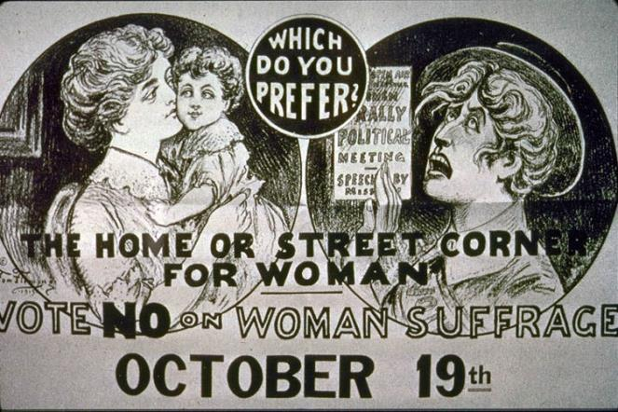
Biggest Problem: Apathy
Most women didn’t want the vote.
Historian Nancy Woloch described early suffragists’ efforts as “a crusade in search of a constituency.”
Lithograph, 1915
The History Project, University of California Davis

Slide 7
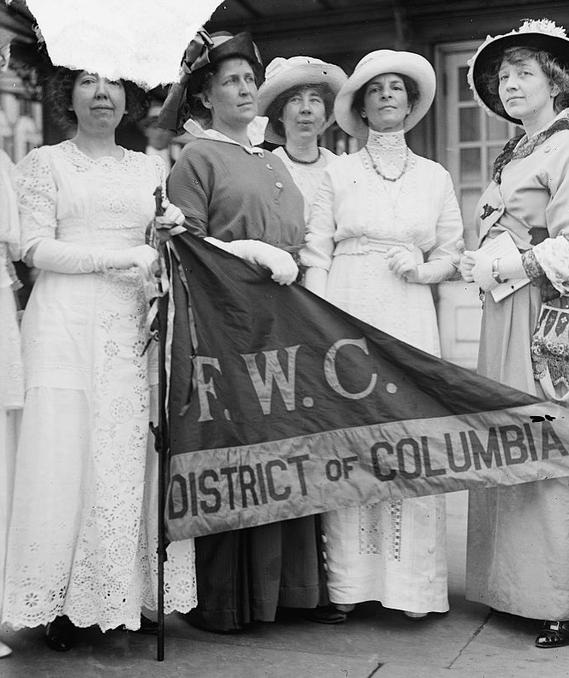
Progressive Era
Middle-class women join clubs—for self-education, to promote temperance, to improve communities, to support charities.
“Women’s Sphere” expands.
Idea of “Social Housekeeping”: Women are responsible for children and home—but can only protect home if they can improve society.
Women organize for temperance, safe food and drug laws, etc.
Women realize: suffrage will increase their influence.
Federation Of Women's Clubs, D.C. Leaders Of Delegation To White House, 1914, Source: Library of Congress

Slide 8
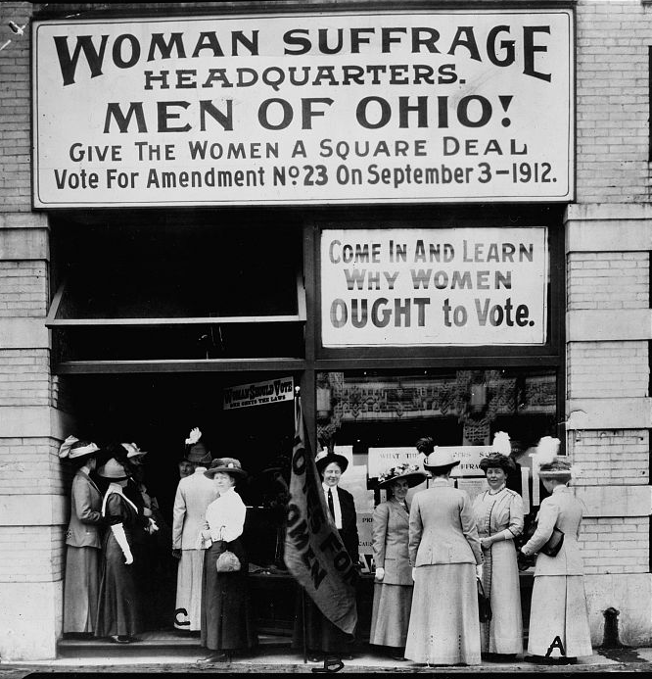
Reinvigorated Suffrage Movement
1890, NSWA and ASWA merge to form National American Woman Suffrage Association (NAWSA).
Focus on state-by-state strategy.
  (Remember: Voting rights at this time are determined by each state—which is why Southern states are able to keep blacks from voting by passing grandfather clauses, poll taxes, and literacy tests.)
Suffrage Headquarters, Cleveland, Ohio, 1912
Source: Library of Congress

Slide 9
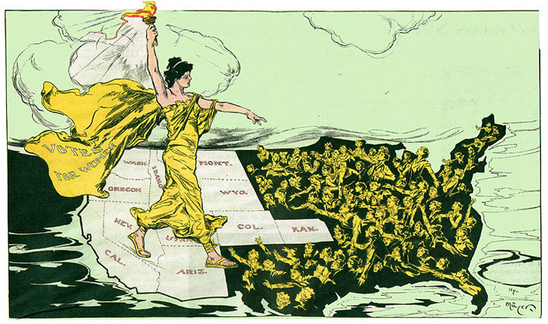
States pass voting rights
Wyoming (1869)
Colorado (1893)
Utah (1896)
Idaho (1896)
Washington (1910)
California (1911)
Oregon (1912)
Kansas (1912)
Arizona (1912)
Montana (1914)
Nevada (1914)
Ca. 1915, Source: Shaping San Francisco Digital Archives

Slide 10
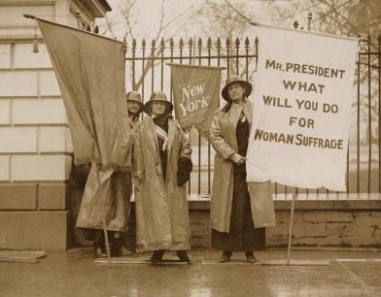
… but not fast enough!
1913: Alice Paul forms Congressional Union to advocate for a federal constitutional amendment.
Congressional Union renamed National Woman’s Party.
Paul’s group adopts militant tactics of English suffragists:
    Picketing
    Mass rallies and marches
NWP attracts young people and revitalizes push for national amendment.
National Woman’s Party New York Day Picket, Jan. 26, 1917, Source: Library of Congress,

Slide 11
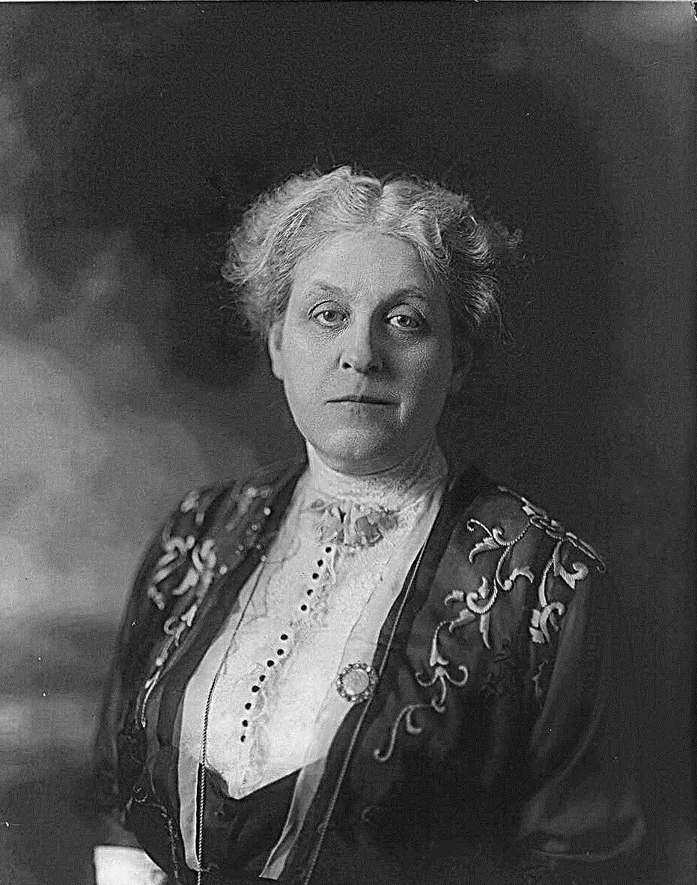
NAWSA and Carrie Chapman Catt
1915 Catt becomes president of NAWSA.
Offers “Winning Plan”
    Win enough states and congress will have to support a national amendment (or women will vote them out).
Sees victories in Arkansas and New York in 1917.
Carrie Chapman Catt, 1914
Source: Library of Congress

Slide 12
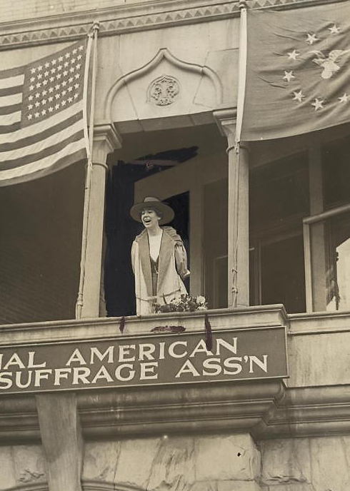
1917: A Pivotal Year
Jeannette Rankin becomes first woman elected to U.S. Congress (she is from Montana!).
U.S. enters World War I.
Jeannette Rankin, Washington, D.C., April 2, 1917. Source: Library of Congress

Slide 13
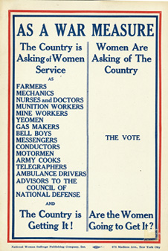
Conflicting Strategies
NAWSA and Carrie Chapman Catt support the war effort (they believe women will be rewarded for loyal service).
Alice Paul and NWP members picket White House, asking for “Democracy at Home”. (seen as unpatriotic).
NAWSA broadside, ca. 1918
Source: Bryn Mawr College Library Special Collections

Slide 14
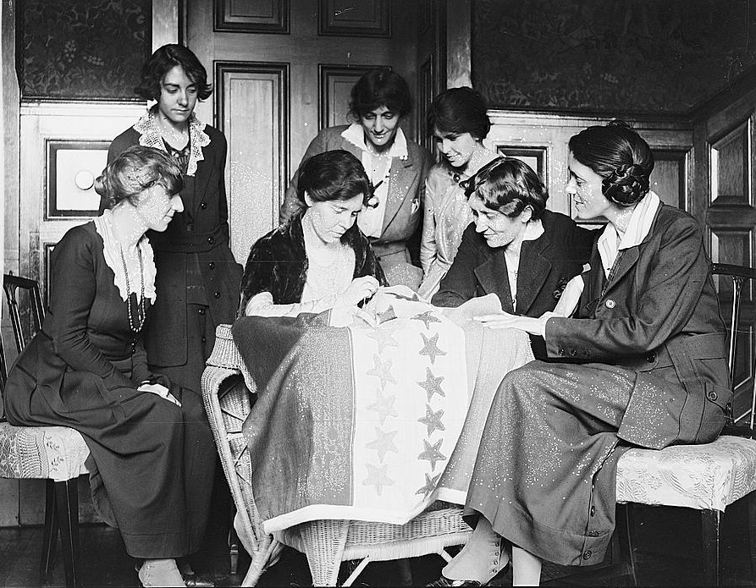
Victory!
Constitutional amendments must
    Pass both House and Senate with two-thirds majorities
    Pass three-quarters of the state legislatures (36 in 1920)
Nineteenth Amendment passes both houses of Congress in June 1919.
State-by-state fight for ratification begins.
    August 26, 1920: Tennessee becomes 36th state to ratify. Nineteenth Amendment becomes law of the land.
Activists watch Alice Paul sew a star onto the NWP Ratification Flag, representing another state's ratification of the 19th Amendment. Source: Library of Congress

Slide 15
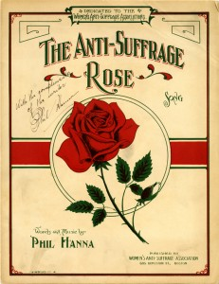
Ratification Fight in Tennessee
Lobbyists converge on Tennessee for “War of the Roses.”
    Anti-suffrage: Red Roses
    Pro-suffrage: Yellow Roses
State senate passed suffrage amendment.
State House was too close to call.
Sheet Music, 1915
Source: University of Houston Libraries

Slide 16
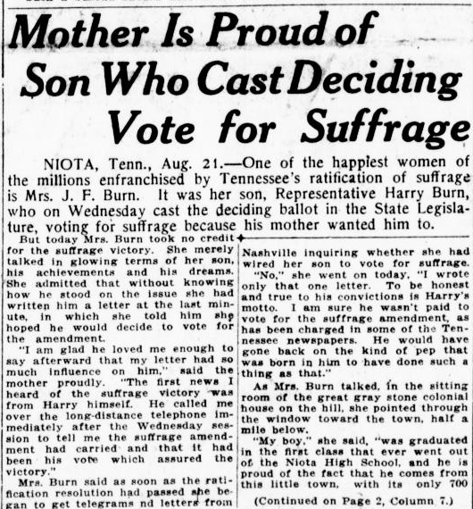
Harry Burn Votes Aye
At 22, Burn is Tennessee’s youngest elected official.
Arrives wearing red rose.
Vote is tied 48-48.
In Burn’s pocket is a letter from his mother:
  “Dear Son: Hurrah and vote for suffrage! Don't keep them in doubt! … Don't forget to be a good boy and help Mrs. Catt put the "rat" in ratification.”
Burn later explains: “I knew that a mother’s advice is always safest for a boy to follow.”
After Burn votes YES, he has to flee an anti-suffrage mob!
Washington Times., August 21, 1920
Source: Chronicling America

Slide 17
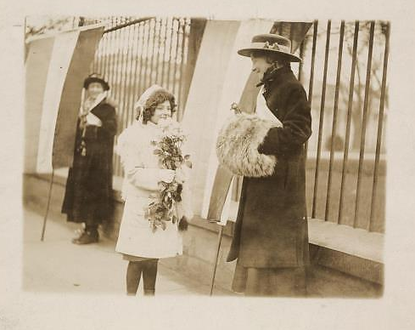
Your question:
What role does Hazel Hunkins play in this larger story?
Is she significant enough to merit a mention in the next edition of your textbook?
Girl presenting flowers to Congressional Union activists picketing the Whitehouse, January 1917. Hazel Hunkins looks on from the far left.
Source: Library of Congress

Slide 18
Image Sources
Image sources:
Slide 1—Sewall-Belmont House and Museum, Washington, D.C., http://americanhistory.si.edu/exhibitions/national-woman-suffrage-parade
Slide 2—Library of Congress, http://hdl.loc.gov/loc.rbc/rbcmil.scrp4006701
Slide 3—Library of Congress, http://www.loc.gov/item/2003690776/
Slide 4—Library of Congress, http://www.loc.gov/item/mnwp000330/
Slide 5— Library of Congress, http://www.loc.gov/item/mnwp000330
Slide 6— Library of Congress, http://memory.loc.gov/ammem/naw/stonblac.jpg
Slide 7—The History Project, University of California Davis, http://historyproject.ucdavis.edu/ic/image_details.php?id=2815
Slide 8— Library of Congress, http://hdl.loc.gov/loc.pnp/hec.04476
Slide 9— Library of Congress, http://www.loc.gov/pictures/item/97500065/
Slide 10—Shaping San Francisco Digital Archives, http://foundsf.org/index.php?title=File:Votes-for-Women-11-western-states.jpg
Slide 11— Library of Congress, http://hdl.loc.gov/loc.mss/mnwp.160033
Slide 12— Library of Congress, http://hdl.loc.gov/loc.pnp/cph.3a29251
Slide 13— Library of Congress, https://www.loc.gov/resource/mnwp.156007
Slide 14— From Bryn Mawr College Library Special Collections, http://www.brynmawr.edu/library/exhibits/suffrage/wwi.html#broadside
Slide 15— Library of Congress, http://hdl.loc.gov/loc.mss/mnwp.160073
Slide 16— University of Houston Libraries,
http://weblogs.lib.uh.edu/speccol/2014/05/21/anti-suffragist-sheet-music/
Slide 17— Library of Congress, http://chroniclingamerica.loc.gov/lccn/sn84026749/1920-08-21/ed-1/seq-1/#
Slide 18— Library of Congress, http://hdl.loc.gov/loc.mss/mnwp.160019

Slide 19
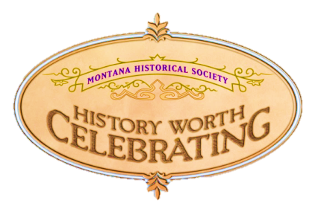

Montana Historical Society
Outreach and Education Program
P.O. Box 201201, Helena, MT 59620
406-444-4740
For the accompanying lesson plan
and more information, visit: http://mhs.mt.gov/education/women/HazelHunkins
Notes:
Logo and ADA revision added 12/2025

