Slide 1
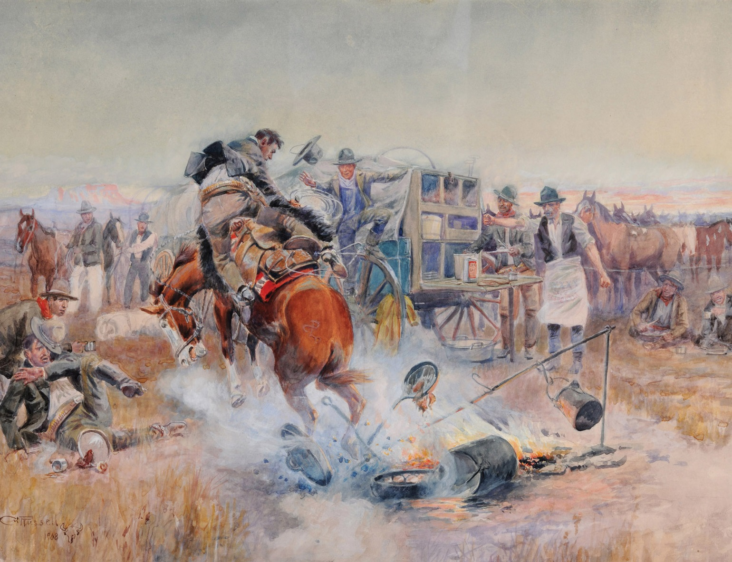
Notes:
Bronc to Breakfast
Charles M. Russell (1864–1926)
Watercolor, 1908
Montana Historical Society Mackay Collection, X1952.01.06
Russell did not tell us who or what inspired this painting. Several people have claimed to be the unlucky cowboy on this early morning ride. The most common story identifies Frank “Doc” Nelson as the rider. Nelson claimed that one morning he saddled a particularly bad-tempered horse that had bucked him off the day before. Nelson bragged to Russell that he “was going to give the pony another try.” Russell responded, “Go ahead, I’ll be watching.” Nelson mounted and later recalled that the horse “happened to be headed right for the fire and about three jumps put him in it.” Charlie pictured himself in Bronc to Breakfast, seated on the right with a plate of food, watching as the twisting bronc kicks the morning coffee, bacon-filled frying pan, and Dutch oven biscuits into the fire.
It is certainly possible that Nelson’s story is correct. It is also likely that the scene is mythical. Russell very likely retold a common cowboy yarn in this painting, rather than depicting a specific event. The fact that Russell painted several versions of this scene lends weight to this second theory.

Slide 2
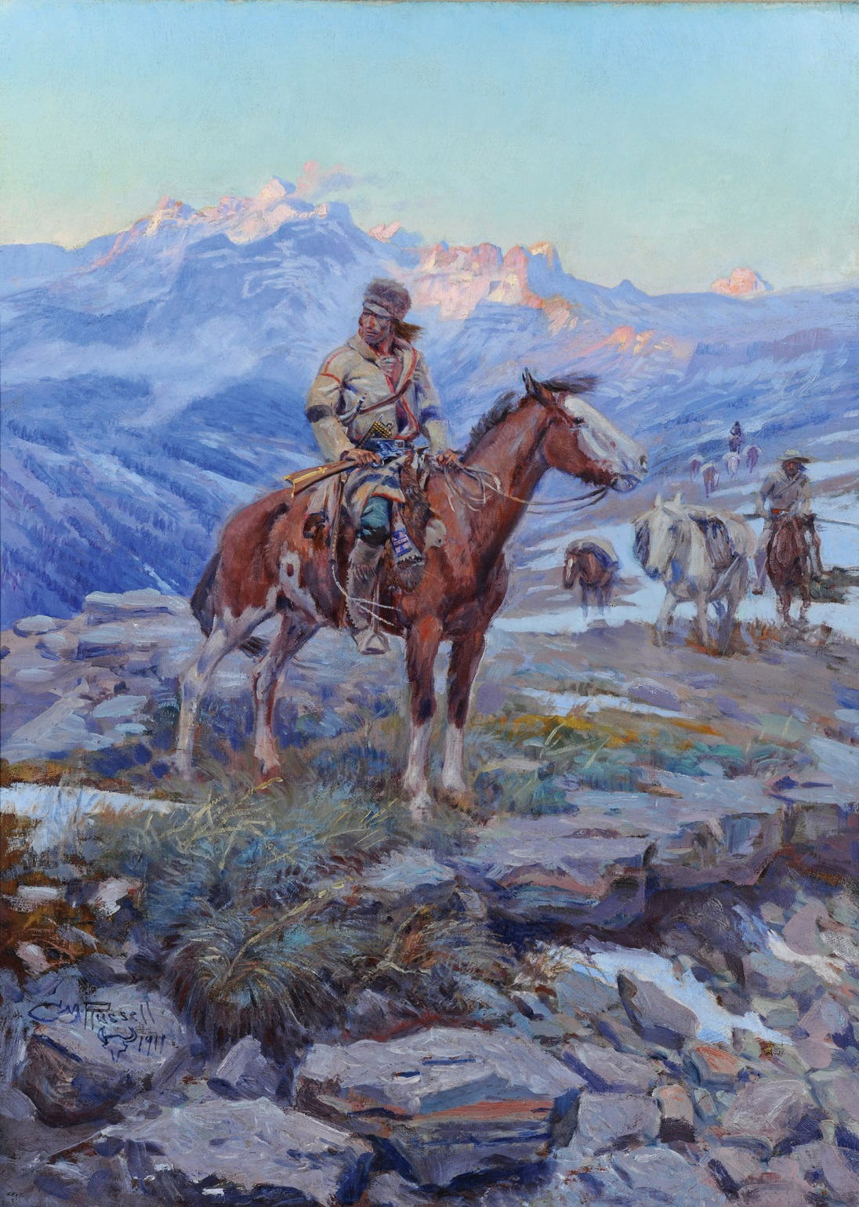
Notes:
Free Trapper
Charles M. Russell (1864–1926)
Oil on canvas, 1911
Montana Historical Society Mackay Collection, X1952.03.02
Charlie Russell grew up in St. Louis, Missouri. That city served as a gateway between the well-established areas of the eastern United States and the “unsettled” regions of the West. Russell is now known for his paintings of cowboys. The frontier character that first captured his attention, however, was the mountain man. Early Montana adventurer John Healy (1837–1908) stated that a mountain man “outfitted with a good horse, rifle and knife could not only support life in the most remote canyons of the Rockies … but he could live in comfort. ... With this meager equipment he was the most independent and self-reliant man on earth.” Russell certainly would have agreed. Free Trapper is a tribute to this romantic figure of his youth.

Slide 3
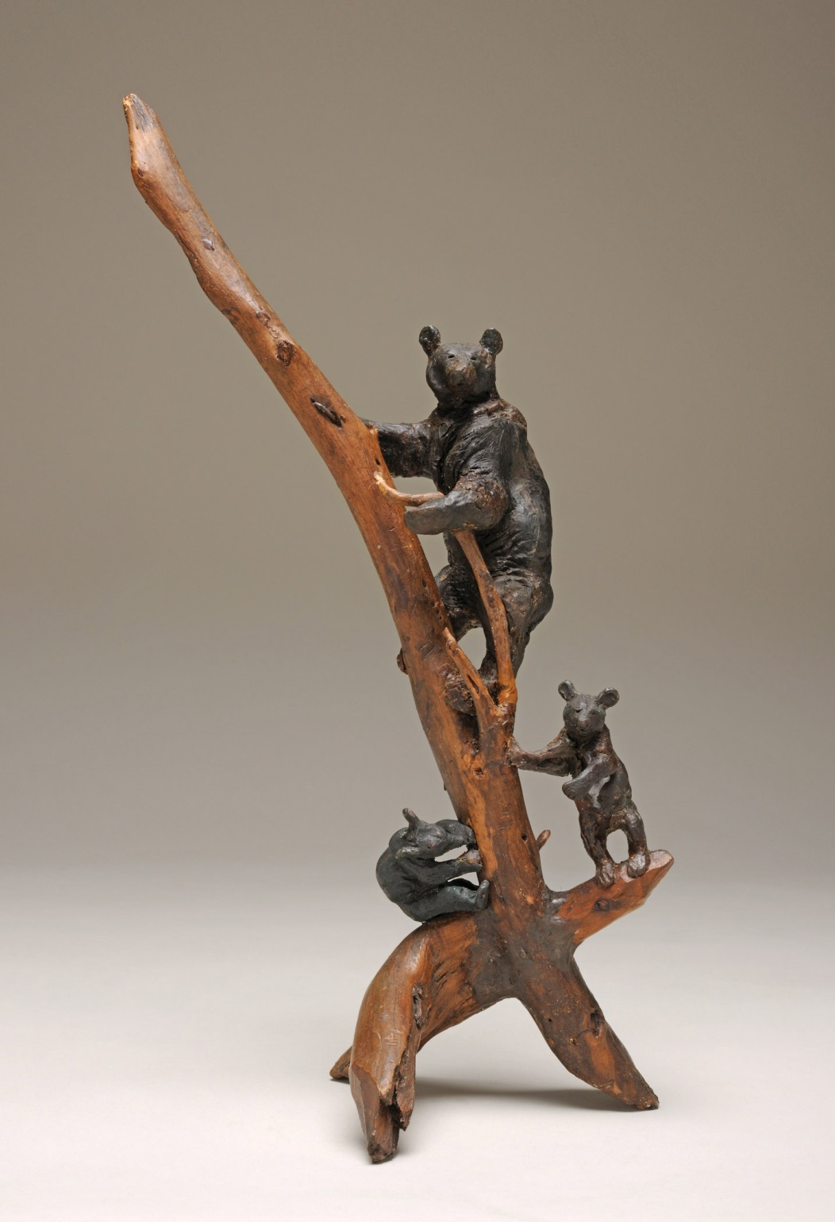
Notes:
Honey Hunters
Charles M. Russell (1864–1926)
Wax and wood, 1920
Montana Historical Society Collection, Gift of Mrs. Edwin G. Lapeyre, X1973.19.01
When Charlie Russell was a young boy he made horses out of flower-making wax that he “borrowed” from his sister Susan. She later recalled that her younger brother “always carried a chunk of wax in his pocket & modeled almost incessantly.” Charlie also used clay that he found on his family’s property to make models of horses and other figures.
Charlie’s boyhood habit of sculpting continued throughout his life. As an adult, he loved to make models no matter where he was. Whether he was night-herding horses on the range, at home in his studio in Great Falls, or at his summer cabin on Lake McDonald in Glacier National Park, Charlie always carried a lump of wax in his pocket. He could make realistic figures even when he could not see what his hands were doing.

Slide 4
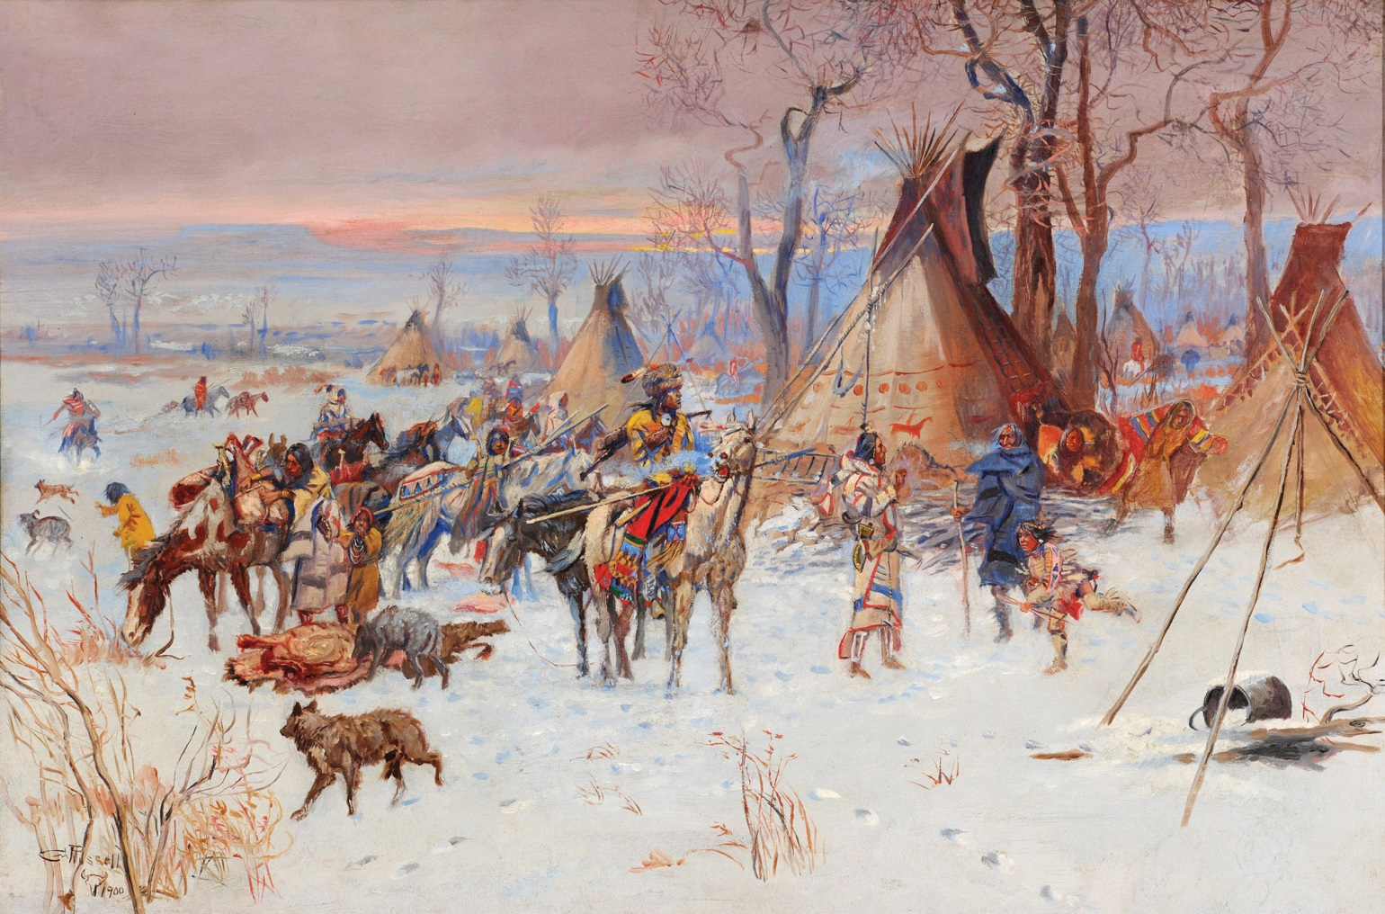
Notes:
Indian Hunters Return
Charles M. Russell (1864–1926)
Oil on canvas, 1900
Montana Historical Society Mackay Collection, X1954.02.01
This painting shows successful hunters returning to their winter camp at the end of day. They bring with them buffalo meat and hides needed for their families’ survival. The Indians are part of the Blood tribe who live in southern Alberta. The Blood are closely related to Montana’s Blackfeet people.
Russell could not have personally seen this event. It depicts a time long before Charlie came to Montana. However, Russell worked hard to make sure that his paintings of “the buffalo days” were accurate. He read accounts written by people who had seen such events, he studied the works of earlier artists, and he visited with tribal members who were old enough to remember life before reservations were established.

Slide 5
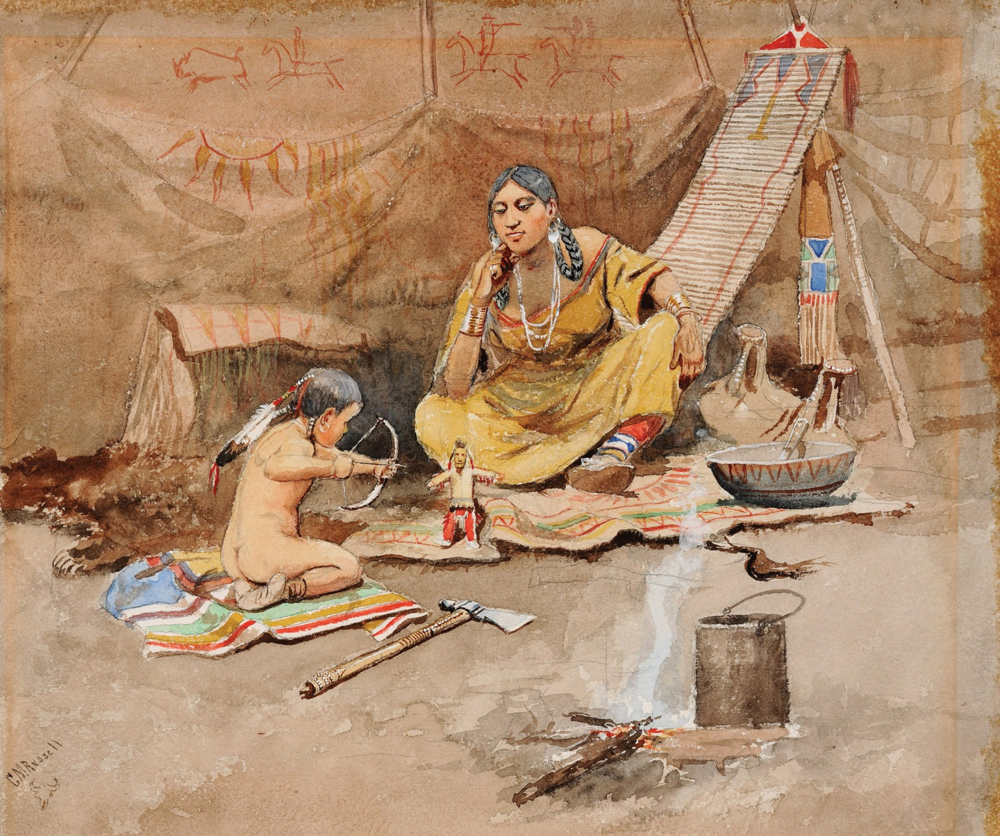
Notes:
Inside the Lodge
Charles M. Russell (1864–1926)
Watercolor, 1893
Montana Historical Society Collection, Bequest of Maude and Florence Fortune, X1954.01.02
Russell often depicted Indian women in domestic scenes like this one. In contrast to his action-packed portrayals of Indians hunting buffalo or cowboys roping steers, such paintings showed Native American women quietly caring for their families. In Inside the Lodge, a young boy plays with a small bow and arrow. This play will help him develop a skill he will need as a hunter and warrior when he grows up. His mother watches approvingly.
Charlie owned a large collection of Native American items and cowboy gear. He studied these artifacts so he could make his artwork realistic. In his studio he had several items like the ones portrayed in this painting, including the backrest against which the mother leans and the tomahawk on the floor.

Slide 6
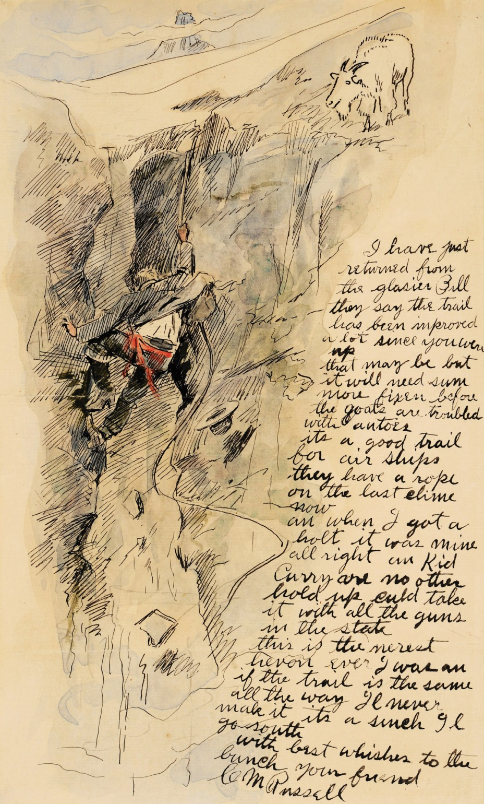
Notes:
I Have Just Returned from the Glasier Bill
Letter to William H. “Bill” Rance, September 4, 1908
Watercolor and ink: Letter, 10” H x 6⅛” W; envelope 3½” H x 6½” W
Montana Historical Society Great Falls Elks Club Collection, 1986.06.21, &1986.06.23
Although highly skilled with a paintbrush, writing was a true chore for Montana’s Cowboy Artist. Russell let his wife Nancy write his business letters, saving his effort for his closest friends. His letters were usually short and filled with misspellings, but they were also usually illustrated with funny sketches. Many of Charlie’s letters were sent as thank-you notes, acknowledging some gift or other kindness. Others were written while the Russells traveled outside of Montana to show and sell Charlie’s art.
Russell wrote this letter during his summer vacation at his cabin in Glacier National Park. He sent it to his good friend Bill Rance who owned the Silver Dollar Bar in Great Falls. In the letter, Charlie describes an outing he took. “I have just returned from the glasier,” he informed his friend. “They say the trail has been improved a lot since you were up. That may be but it will need sum more fixen before the goats are troubled with autoes.” To illustrate his adventure, Charlie pictured himself in a dangerous spot, scrambling up a rocky cliff while a mountain goat watches on. “They have a rope on the last clime now,” he continued, “an when I got a holt it was mine all right and Kid Curry are [or] no other hold up culd take it with all the guns in the state. This is the nerest hevon [heaven] ever I was.”

Slide 7
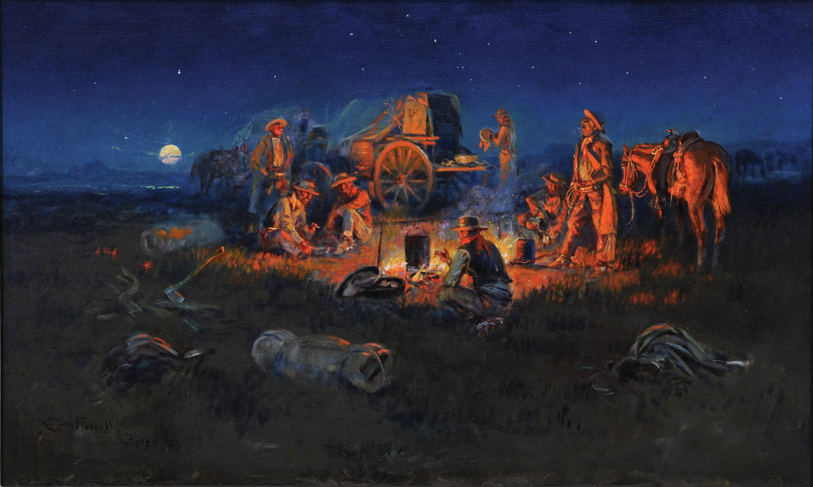
Notes:
Laugh Kills Lonesome
C.M. Russell
Oil on canvas, 1925
Montana Historical Society Mackay Collection, X1955.01.01
Charlie painted Laugh Kills Lonesome at the end of his career. The romantic nature of this painting shows Russell’s longing for the “West that had passed.” He included himself in the scene, standing with his horse to the right of the campfire. The DHS brand on the chuck wagon indicates that it is part of the Davis, Hauser, and Stuart Cattle Company (which was owned by A.J. Davis, Sam Hauser, and Granville Stuart—all prominent men in Montana’s early history). Charlie had ridden with the DHS outfit as a young man. The youthful friendships that he made while working for the DHS and other brands remained strong throughout his life. “In the city men shake hands and call each other friends,” he recalled many years after he quit being a cowboy, “but it’s the lonsome places that tie their harts together and harts do not forget.”
In 1926 Charlie was invited to a roundup but poor health kept him from going. In declining the invitation he wrote, “I am an old horse rangler one of the has beens. . . . Like most men my age my harte lives back on trails that have been plowed under by the nester. Most of the men that I knew and worked with on the open range have crossed the tall range. Good ore bad it seems to me now when my memory driftes back that they were all good enough, so when it comes to my [time to] cash in I want to go to thair wagon. . . . [And if the Indian] is right when he says hosses go to I want my same string.”

Slide 8
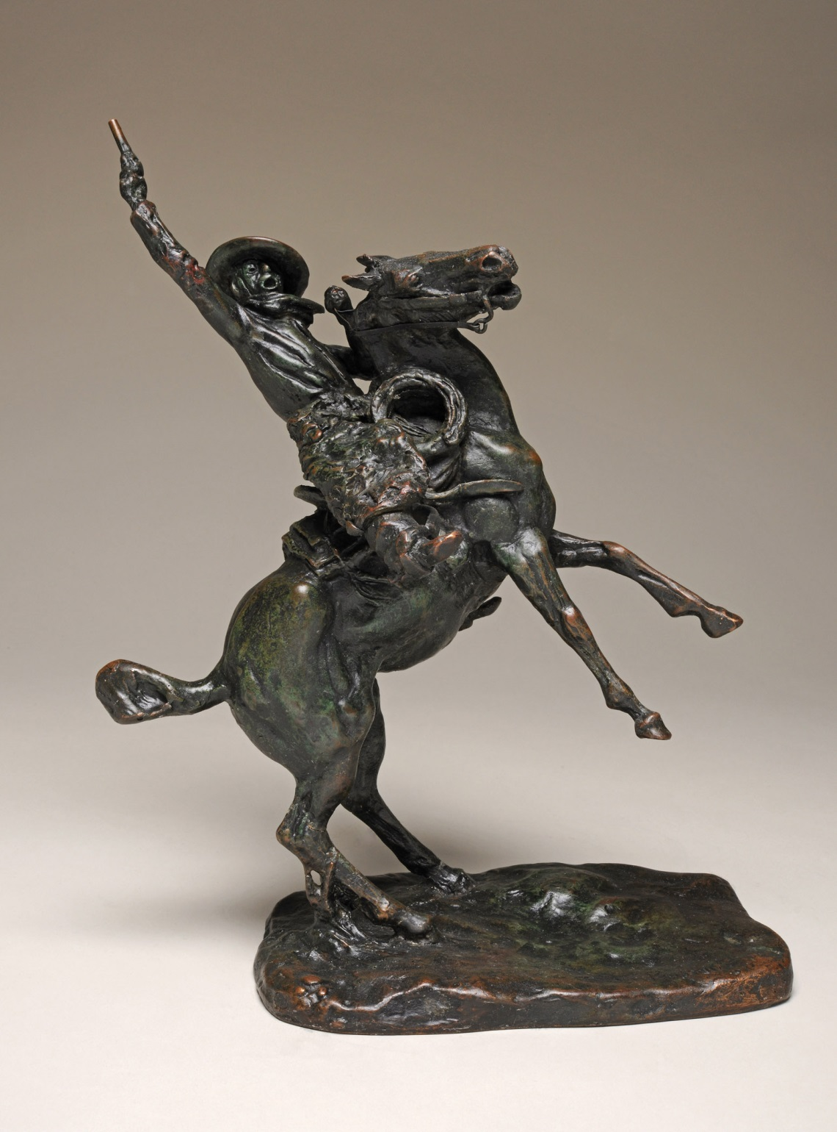
Notes:
Smoking Up
Bronze, the original clay sculpture was modeled by Charles M. Russell in 1904.
This bronze was cast by Roman Bronze Works sometime before 1929.
Montana Historical Society Mackay Collection, X1952.01.35
Smoking Up was the first Russell sculpture to be cast in bronze. He modeled the sculpture while on his visit to New York City. He sold the origi­nal model to the New York Cooperative Society, which then had the piece cast by the Roman Bronze Works. The sculpture depicts a wild cowboy riding a rearing horse, whooping and hollering and shooting his gun in the air. He is “smoking it up” during a visit to town after spending a long time on the dusty trail.
Roman Bronze Works cast Smoking Up from Russell’s original model using the “lost wax” method of bronze casting. In lost wax casting, a mold, which could be reused numerous times, was made from an original model. Melted wax was poured into the mold, which was made of a special material that could withstand high heat. The wax would be melted out, leaving behind a cavity into which melted bronze was poured. When the bronze cooled it formed a permanent sculpture in the shape of the original model. The process could be repeated to make any number of casts. Most of Russell’s bronzes cast during his lifetime were created by this method.

Slide 9
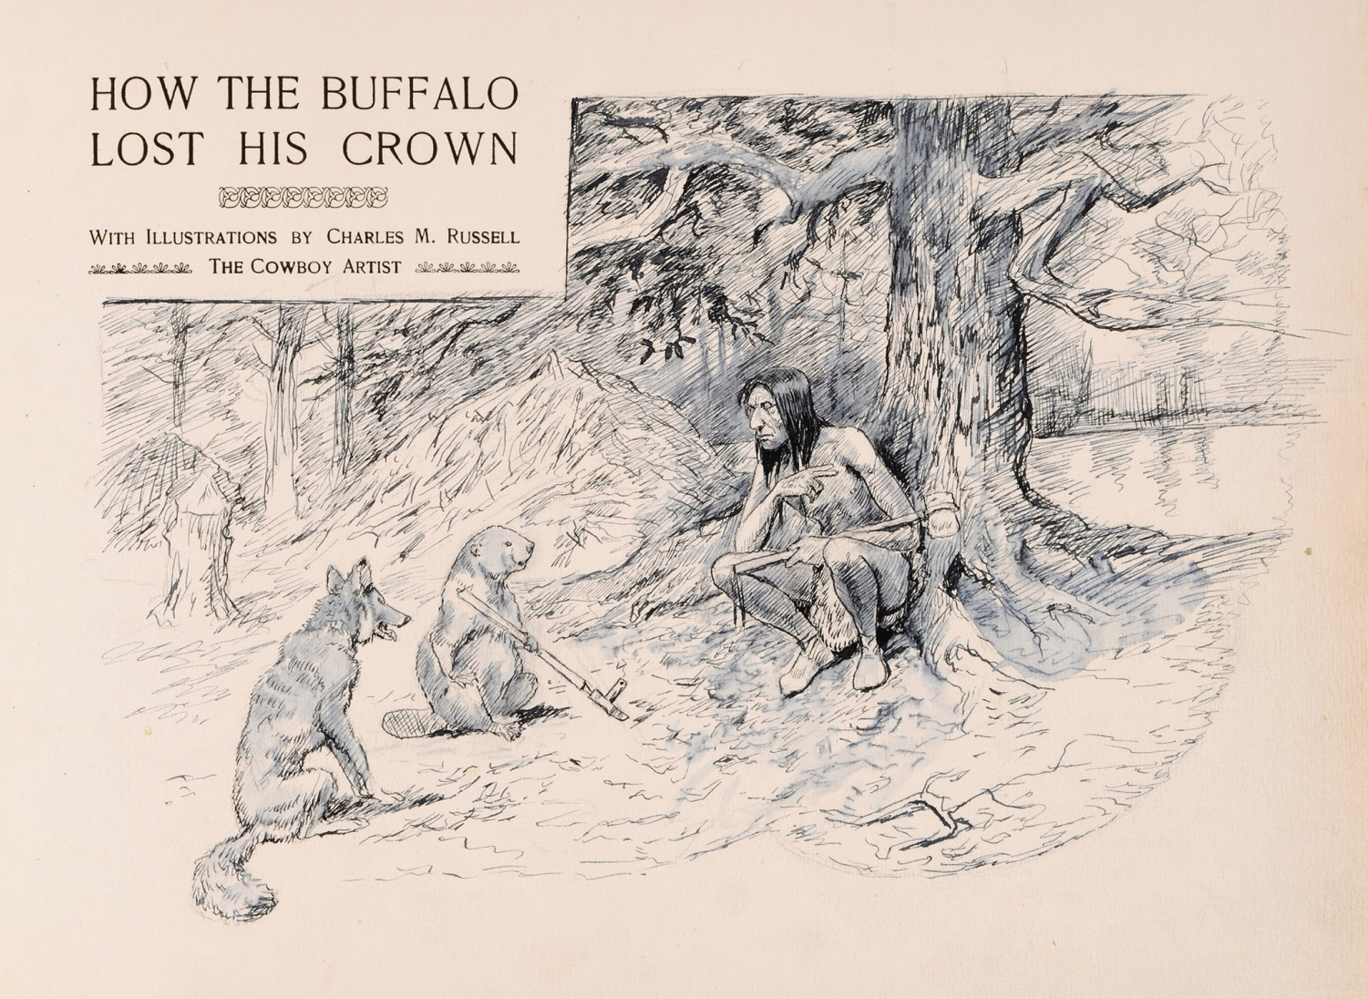
Notes:
Untitled (Indian Talking to Beaver and Fox)
Charles M. Russell (1864–1926)
Ink and white lead, ca. 1894
Montana Historical Society Collection, Gift of Mark H. Brown, 1980.60.01b
According to Blackfeet legend, buffalo were originally in charge of all animals, including humans. How the Buffalo Lost His Crown explains how humans—with help from their animal friends—gained the upper hand over the buffalo. John H. Beacom recorded this Blackfeet story and published it in this book. Beacom was a soldier sta­tioned at Fort Shaw, near Great Falls. He learned the tale from “Old Nis-sú kai-yo, the celebrated orator of the Blackfeet nation.” As Beacom explained, Nis-sú kai-yo was “told me these quaint tales of the ancient time” while “sitting at my camp-fire of an autumn evening.”
Russell provided eight illustrations for the publication. These illustrations included one oil painting, five black-and-white watercolors, and two small sketches. This drawing shows an Indian talking to Beaver and Fox, who are important characters in the story. Russell drew this original illustration in his own copy of the book after it was published.

Slide 10
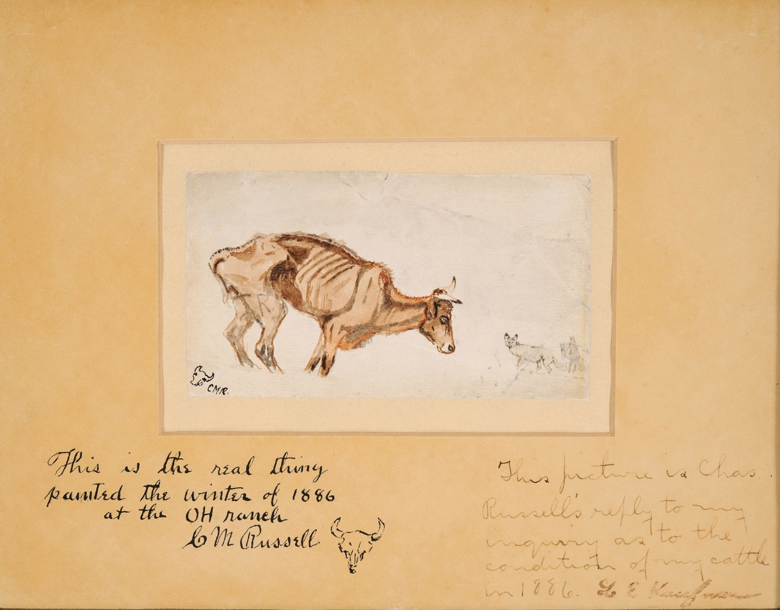
Notes:
Waiting for a Chinook
Charles M. Russell (1864–1926)
Watercolor, 1887
On loan from the Montana Stockgrowers Association, L1953.01.01
The winter of 1886–1887 was extremely harsh. As a result of deep snow and exceptionally cold temperatures, 60 percent of the cattle feeding on Montana ranges died. Russell was working for the OH ranch, which was located in the Judith Basin in central Montana. The owners of the cattle lived in Helena. Russell produced this sketch to answer a letter from one of the owners, who wanted to know how well the cattle were surviving. He painted it on a piece of cardboard that came from a shirt collar box.
Waiting for a Chinook gets its name from the chinook winds that bring warm temperatures to Montana even in the middle of winter. A chinook wind can quickly melt large amounts of snow and raise temperatures from below zero to above freezing in just a few short hours.
Waiting for a Chinook is an extremely powerful image. Although it is very simple, it still tells the full story of the devastation caused by brutal winter weather. It was reproduced in newspapers across the country and started Russell on the path to fame as Montana’s Cowboy Artist.

Slide 11
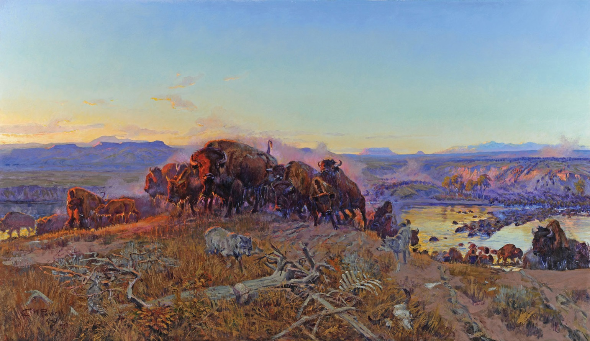
Notes:
When the Land Belonged to God
Charles M. Russell (1864–1926)
Oil on canvas, 1914
Montana Historical Society Collection, X1977.01.01
Many people believe that When the Land Belonged to God is Russell’s masterpiece. It is set on the Missouri River at daybreak, a few miles down­stream from the town of Fort Benton. A small group of bison have just crossed the river and stand, momen­tarily paused, on a rocky hill. The rising sun strikes the faces of the lead buffalo and the distant bluffs, adding drama and color to the scene. Distinctive geographic landmarks—Frenchman’s Ridge, Square Butte, Round Butte, and the Highwood Mountains—can be seen in the distance. Hungry wolves, a bison skeleton, and a beaver-scarred snag complete the picture’s central elements. A sage grouse is hidden in the fore­ground.
Russell painted When the Land Belonged to God for the Montana Club. The Montana club was a private organization for wealthy men in Helena. In the 1970s, the club decided to sell the painting. The state of Montana bought the painting from the club in 1977. When Governor Tom Judge signed the bill that made the purchase official, he said: “The work of Charlie Russell and a handful of other artists and writers has kept those of us who were not fortunate enough to know the Old West firsthand from forgetting her. . . . His paintings—their color, drama and size—bring home to us forcefully the dreams of independence and reverence for nature which underlie the quality of life we Montanans work hard to nurture and defend.”

Slide 12
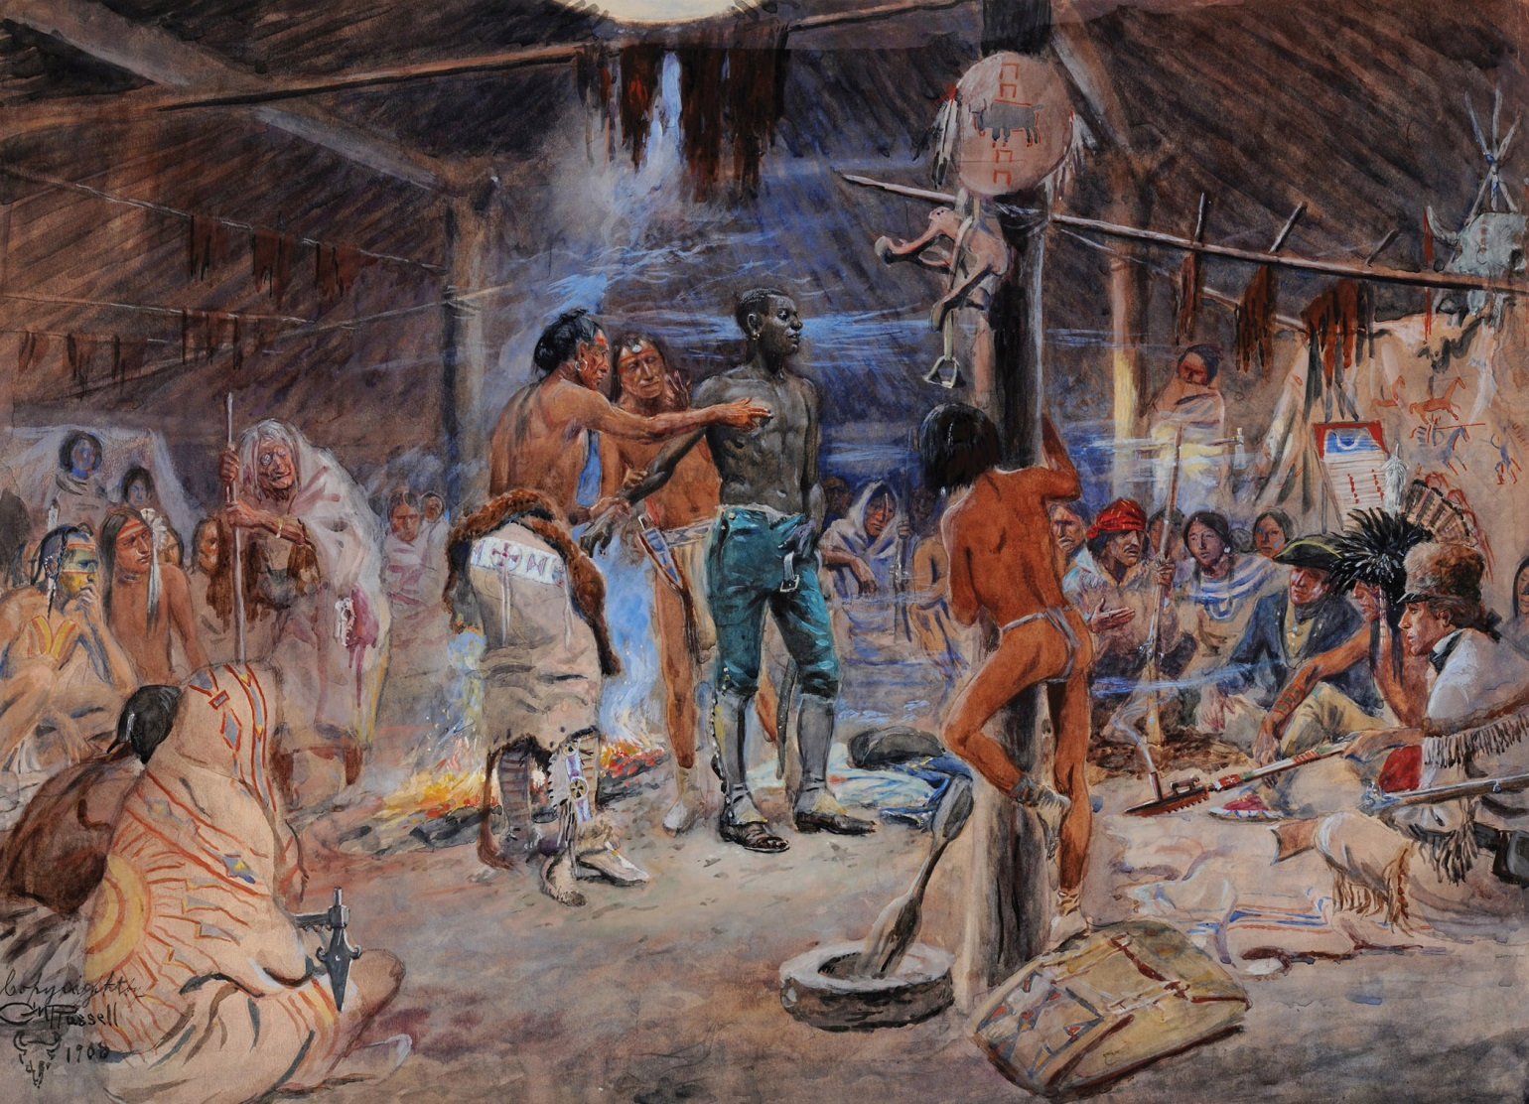
Notes:
York
Charles M. Russell (1864–1926)
Watercolor, 1908
Montana Historical Society Collection, Gift of the Artist, X1909.01.01
This painting depicts an event that occurred on the Lewis and Clark Expedition. The explorers were in present-day North Dakota among the Hidatsa Indians. York was Captain William Clark’s slave and a member of the Corps of Discovery. Many western Indian tribes had never seen an African American person before. York’s dark skin color caused some Indians to believe that he might have special powers. Others, such as Hidatsa chief Le Borgne (shown here), believed that he was only painted black and tried to rub the color off his skin.
This watercolor was the first Russell artwork that the Montana Historical Society acquired. It was presented as a gift from the artist himself in 1909.

Slide 13
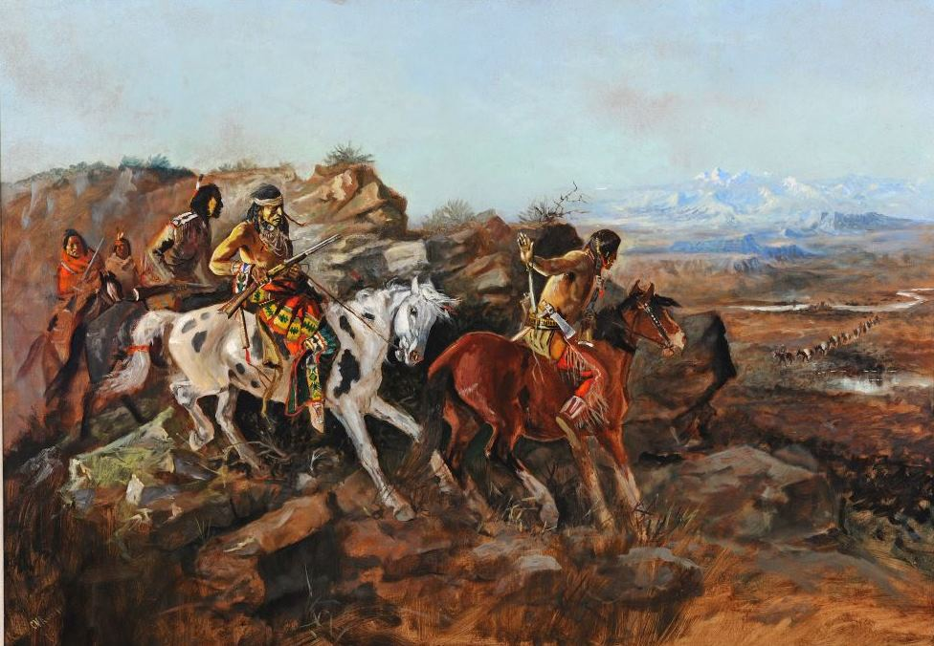
Notes:
The Ambush
Charles M. Russell (1864–1926)
Oil on canvas, 1894
Montana Historical Society Collection, Bequest of Gertrude Mayn Backus, X1968.01.01
Ambushes were a popular topic in Western art and Western fiction because they were exciting. Stories and paintings describing ambushes shaped many people’s views of the West. These images both reflected and reinforced stereotypes about Western life and American Indians.
The Ambush highlights Russell’s skill as a storyteller. The title tells us what probably comes next, but we are drawn into the painting because we wonder how the scene will play out. A California journalist once praised Russell’s ability to tell stories through his paintings. “The story is the thing with this artist. Landscape, decoration, color, harmony, are all subservient to the main issue, the incident.”
Russell painted this picture a year after he left the range to become a full-time artist.
Between 1888 and 1896, he produced at least three other works about ambushes, all with similar compositions. Two of them feature Indians on their mounts paused behind a rocky outcropping, watching unsuspecting white travelers far below. The third uses the same configuration, but the ambushers are not Indians. They are outlaws targeting a stagecoach.

Slide 14
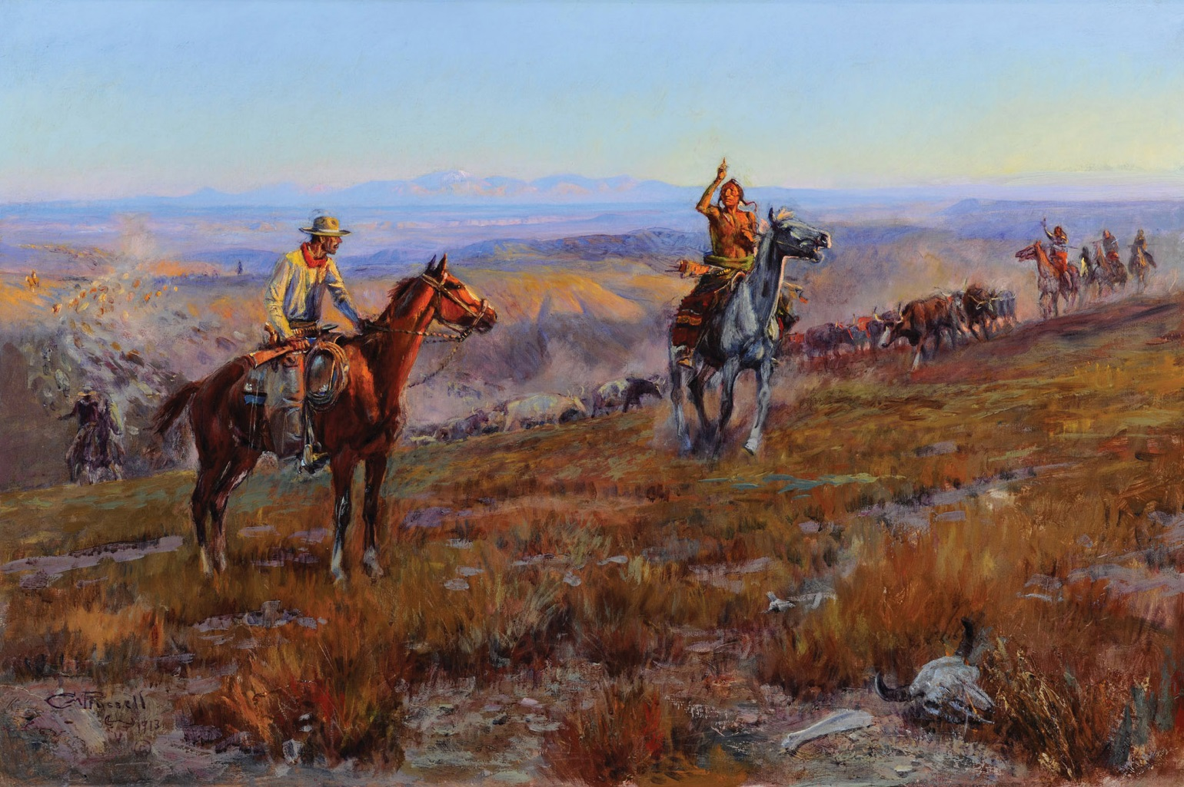
Notes:
Toll Collectors
Charles M. Russell (1864–1926)
Oil on canvas, 1913
Montana Historical Society Mackay Collection, X1952.03.01
Russell painted this picture late in his career. Years of working as an artist had made him a master painter. Toll Collectors illustrates how he used light and shadow, vivid colors, and a looser painting technique to create dramatic pictures.
The painting captures a tense encounter. Indians are demanding a toll in beef to let the cowboys cross their land. In the middle ground on the right, the Indians turn the herd while the trail boss in the foreground sits warily on his horse, with one finger on the trigger of his rifle. Russell leaves it to us to imagine what happens next.
Author Andy Adams tells of a similar encounter in his book, The Log of a Cowboy: A Narrative of the Old Trail, which was published in 1903. In that story, a group of Comanches stopped cowboys who were bringing cattle from Texas to Montana. “The chief laid claim to all the country in sight as the hunting grounds of the Comanche tribe…. He spoke of the great slaughter of buffalo by the white hide-hunters, and the consequent hunger and poverty amongst his people. … When he had fully stated his position, he offered to allow us to pass through his country in consideration of ten beeves.”

Slide 15
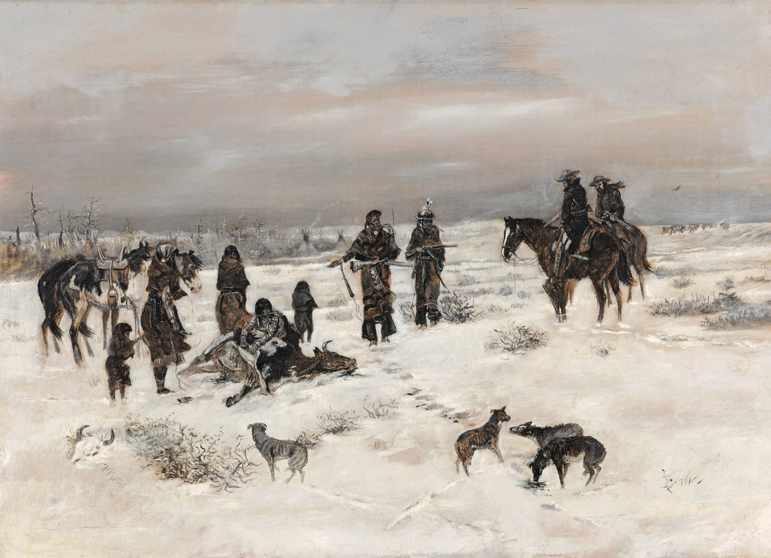
Notes:
Caught in the Act
Charles M. Russell (1864–1926)
Oil on canvas, 1888
Montana Historical Society Mackay Collection, X1952.03.03
Russell’s early work was more realistic, and less romantic, than his later masterpieces. He painted this scene early in his career when his technique was still evolving.
Russell’s choice of colors speaks to the painting’s harsh story. In the early 1880s, hide-hunters had brought the bison close to extinction. Booming white settlements and overhunting made it hard to find other types of game as well. In 1883, early winter storms delayed the delivery of annuities (annual payments the U.S. government owed tribes by treaty; the U.S. government had promised to make these payments in exchange for Indian land.) As a result, many members of the Blackfeet and other tribes starved to death.
Always an expert storyteller, Russell captured a dramatic moment when two cowboys discover a small band of Indians butchering a freshly killed beef. The cowboys seem reluctant to punish the Indians for slaughtering the steer because they know that the tribes are starving. Russell leaves it to us to imagine what happens next, but it is clear he sympathizes with the Indians.
Featured in the May 12, 1888 issue of Harper’s Weekly, Caught in the Act was the first Russell painting to be published in a nationally distributed magazine.

Slide 16
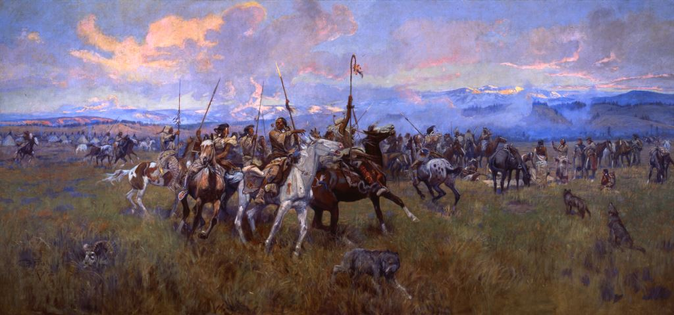
Notes:
Lewis and Clark Meeting Indians at Ross’ Hole. C. M. Russell, oil on canvas, 1912, 140” x 296”. Mural in Montana State Capitol, X1912.06.01

Slide 17
